Slide 1
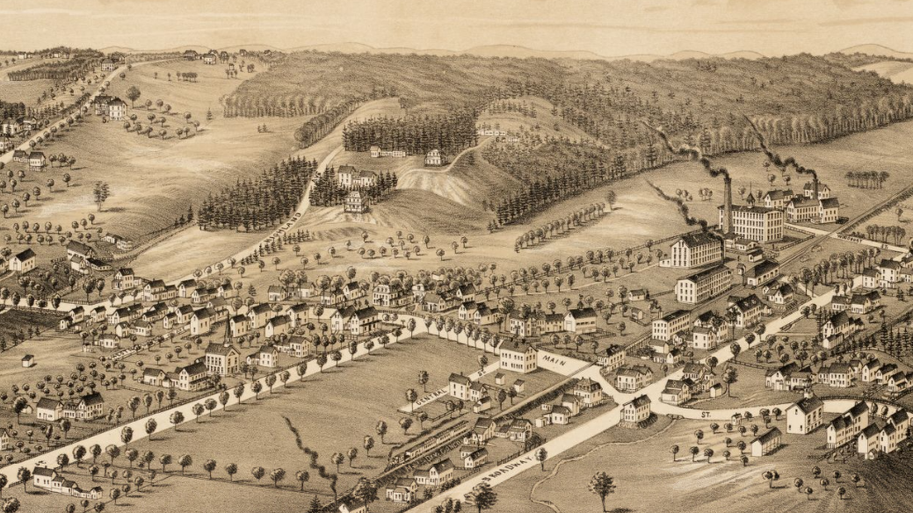
Town of Salem Master Plan
Planning Board Meeting #2 - Draft Plan
February 19, 2025

Slide 2
Agenda
Draft Plan Overview Presentation (~30min)
Process Overview
Vision & Guiding Principles
Plan Pillars & Recommendations:
Gathering Spaces
Town Connectors
Mixed Use Core
Missing Middle Edges
Development Vision Focus Areas: Historic Town Center & Depot Village
Implementation Approach
Planning Board Comments & Discussion (~45min)
Next Steps (~15min)

Slide 3

Planning Process Overview
LEARNING: Issues & Opportunities Identification
VISIONING: Plan Framework & Scenario Development
DEVELOPING THE PLAN: Recommendations & Implementation
DOCUMENTATION: Plan Production & Approval
January
February
March
April
May
June
July
August
September
October
November
December
2025 >>
Steering Committee
Planning Board
Public Engagement Round 1
Public Engagement Round 2
Visioning Survey
Draft Plan Survey
Draft Report
Visioning Comment Cards
Issues & Opportunities
Public Workshop
Draft Plan Framework Public Workshop

Slide 4
Engagement by the Numbers
Events and Tools
4 Steering Committee Meetings
2 Public Workshops & Follow-Up Exhibits at Library and Town Hall
2 Public Surveys
1 Visioning Comment Card Campaign
The Town promoted participation via the Town’s website, Town Hall Times, Facebook, SCTV featurettes, and What’s Up Salem podcast episodes.
Input and Participation
Visioning Survey (online only)
809 people voted
423 statements submitted
64,129 votes cast
Visioning Comment Cards (printed & online)
142 cards submitted
Public Visioning Workshop
~50 Participants
54 board comments
Public Draft Plan Workshop
~30 Participants
28 board comments
287 sticky dot votes
Draft Plan Survey (printed & online)
150+ responses
400+ open comments

Slide 5
Draft Plan Overview Presentation

Slide 6
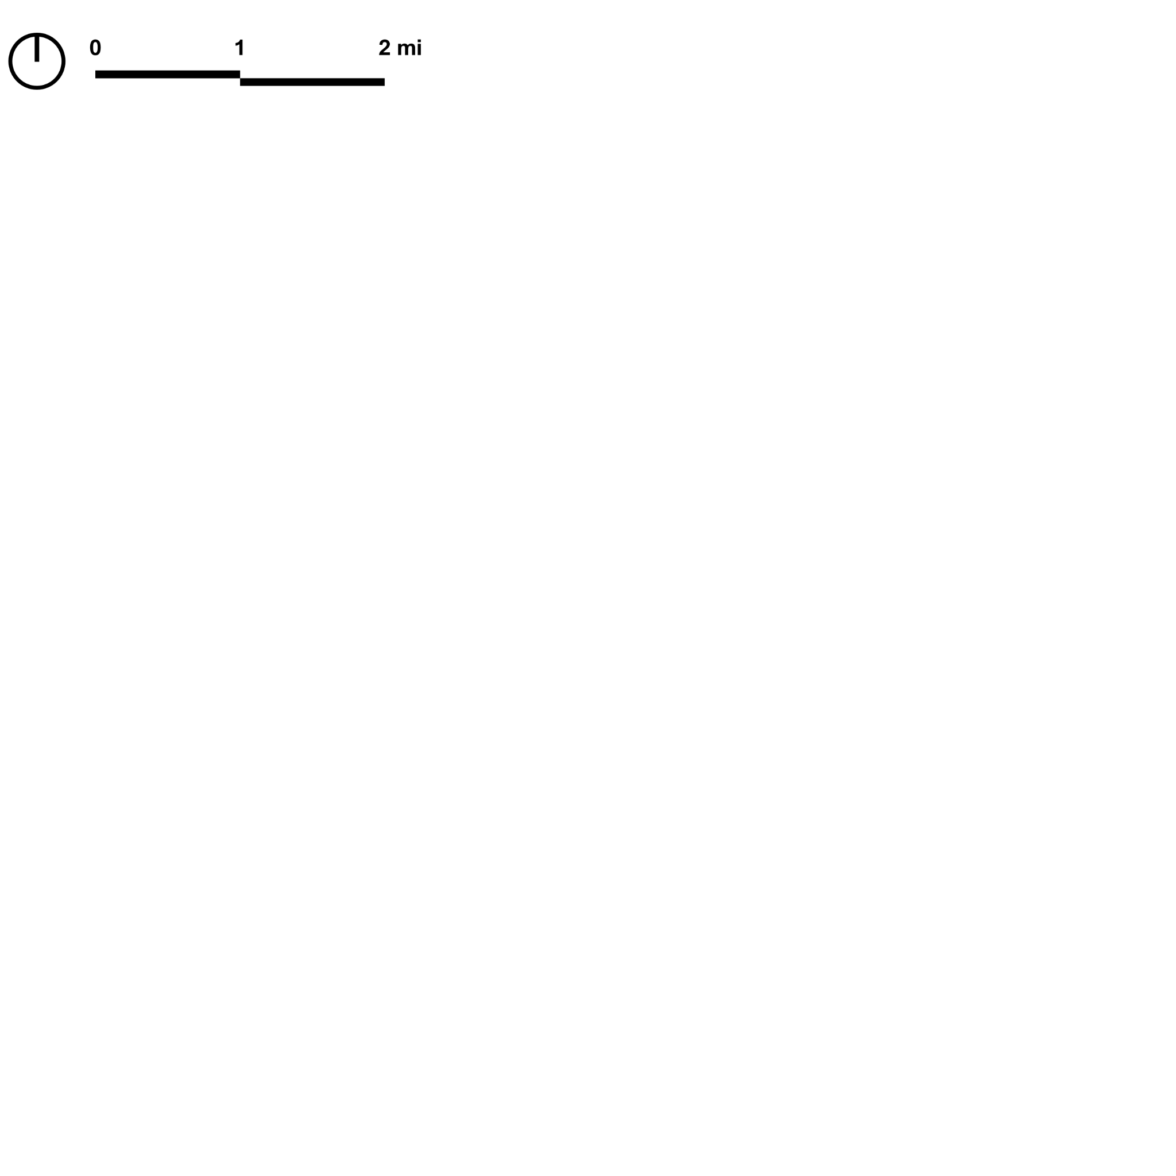
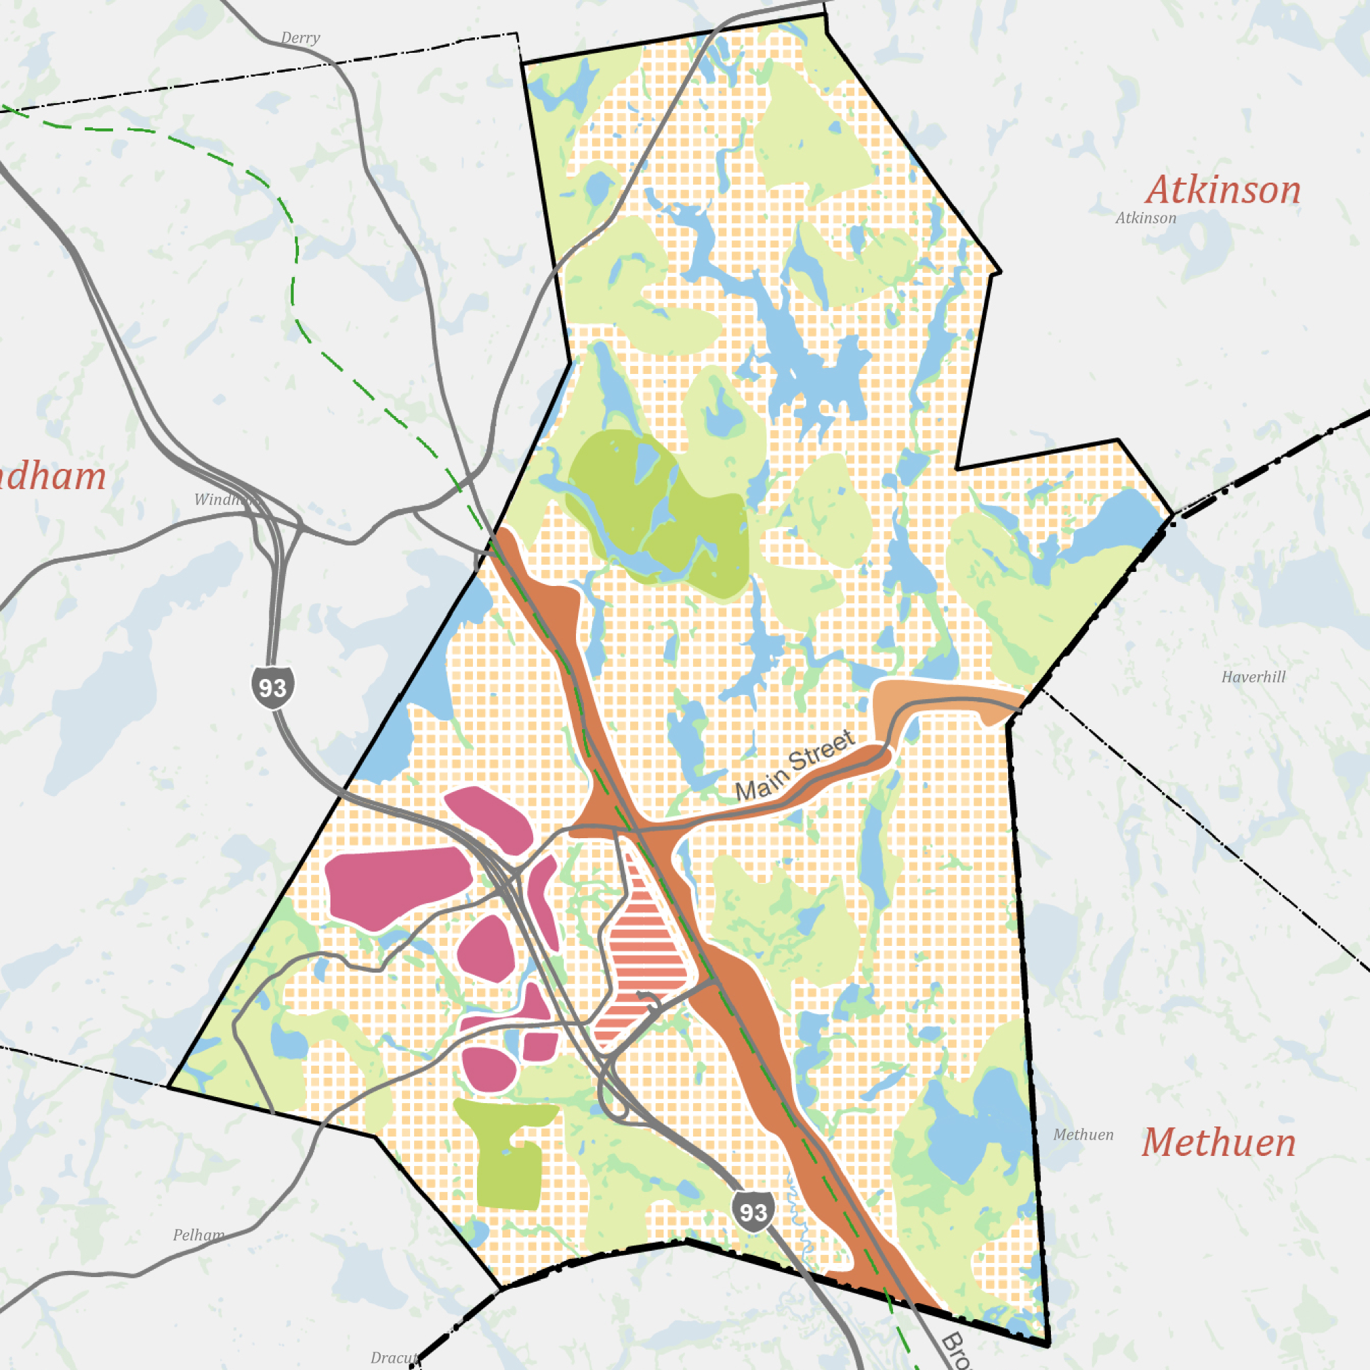
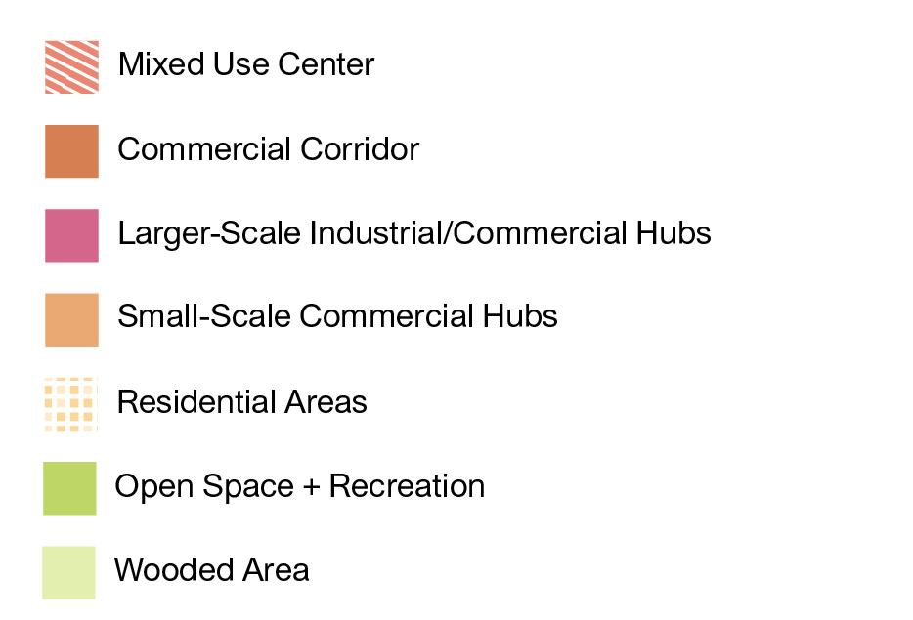
Early Analysis Insights
This map diagrams existing land use and development patterns of Salem.
A couple things stand out:
Major Commercial and Mixed-Use Corridors
Route 28 corridor
Main Street
Commercial/Industrial Areas
Concentrated between Route 28 & I-93
Residential Fabric
Spectrum of suburban to rural
Notes:
This is our distillation based on preliminary reading…

Slide 7
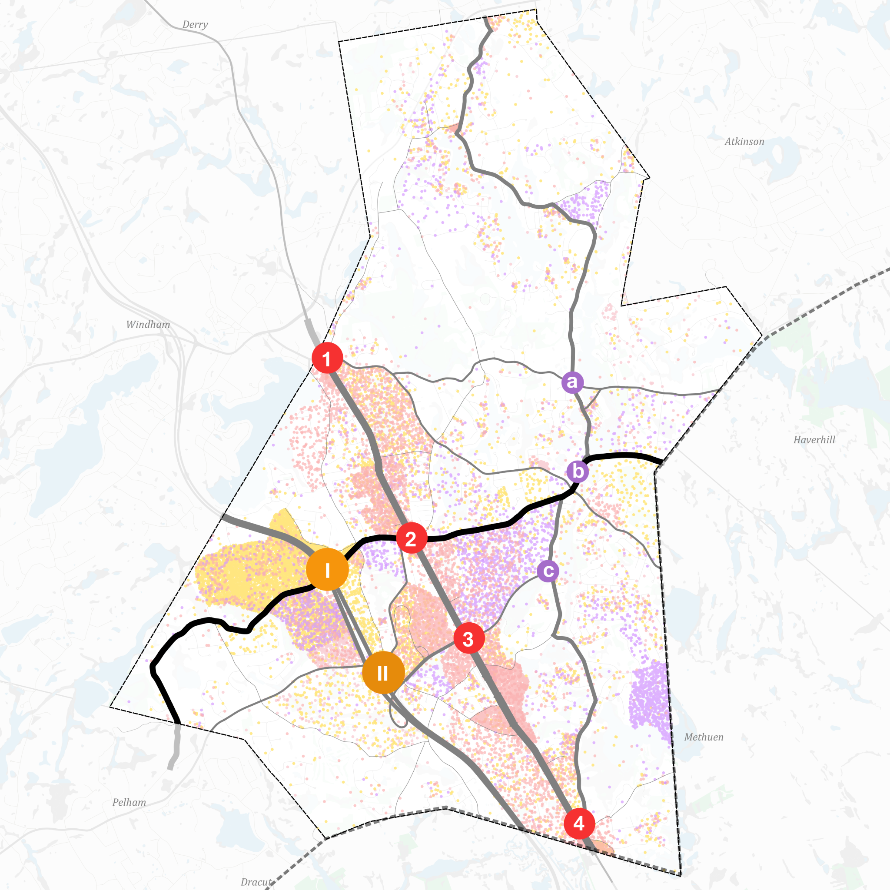
Early Analysis Insights
Main Street is the central connector:
I-93
Rt-28
Lawrence / N Main
1
a
Lake St
Bluff St
I
b
2
Main St / Pelham Rd
Main St
Main St
II
3
c
Rockingham
Park Blvd
Veterans Memorial Pkwy
Veterans Memorial Pkwy
4
Lawrence Road

Slide 8
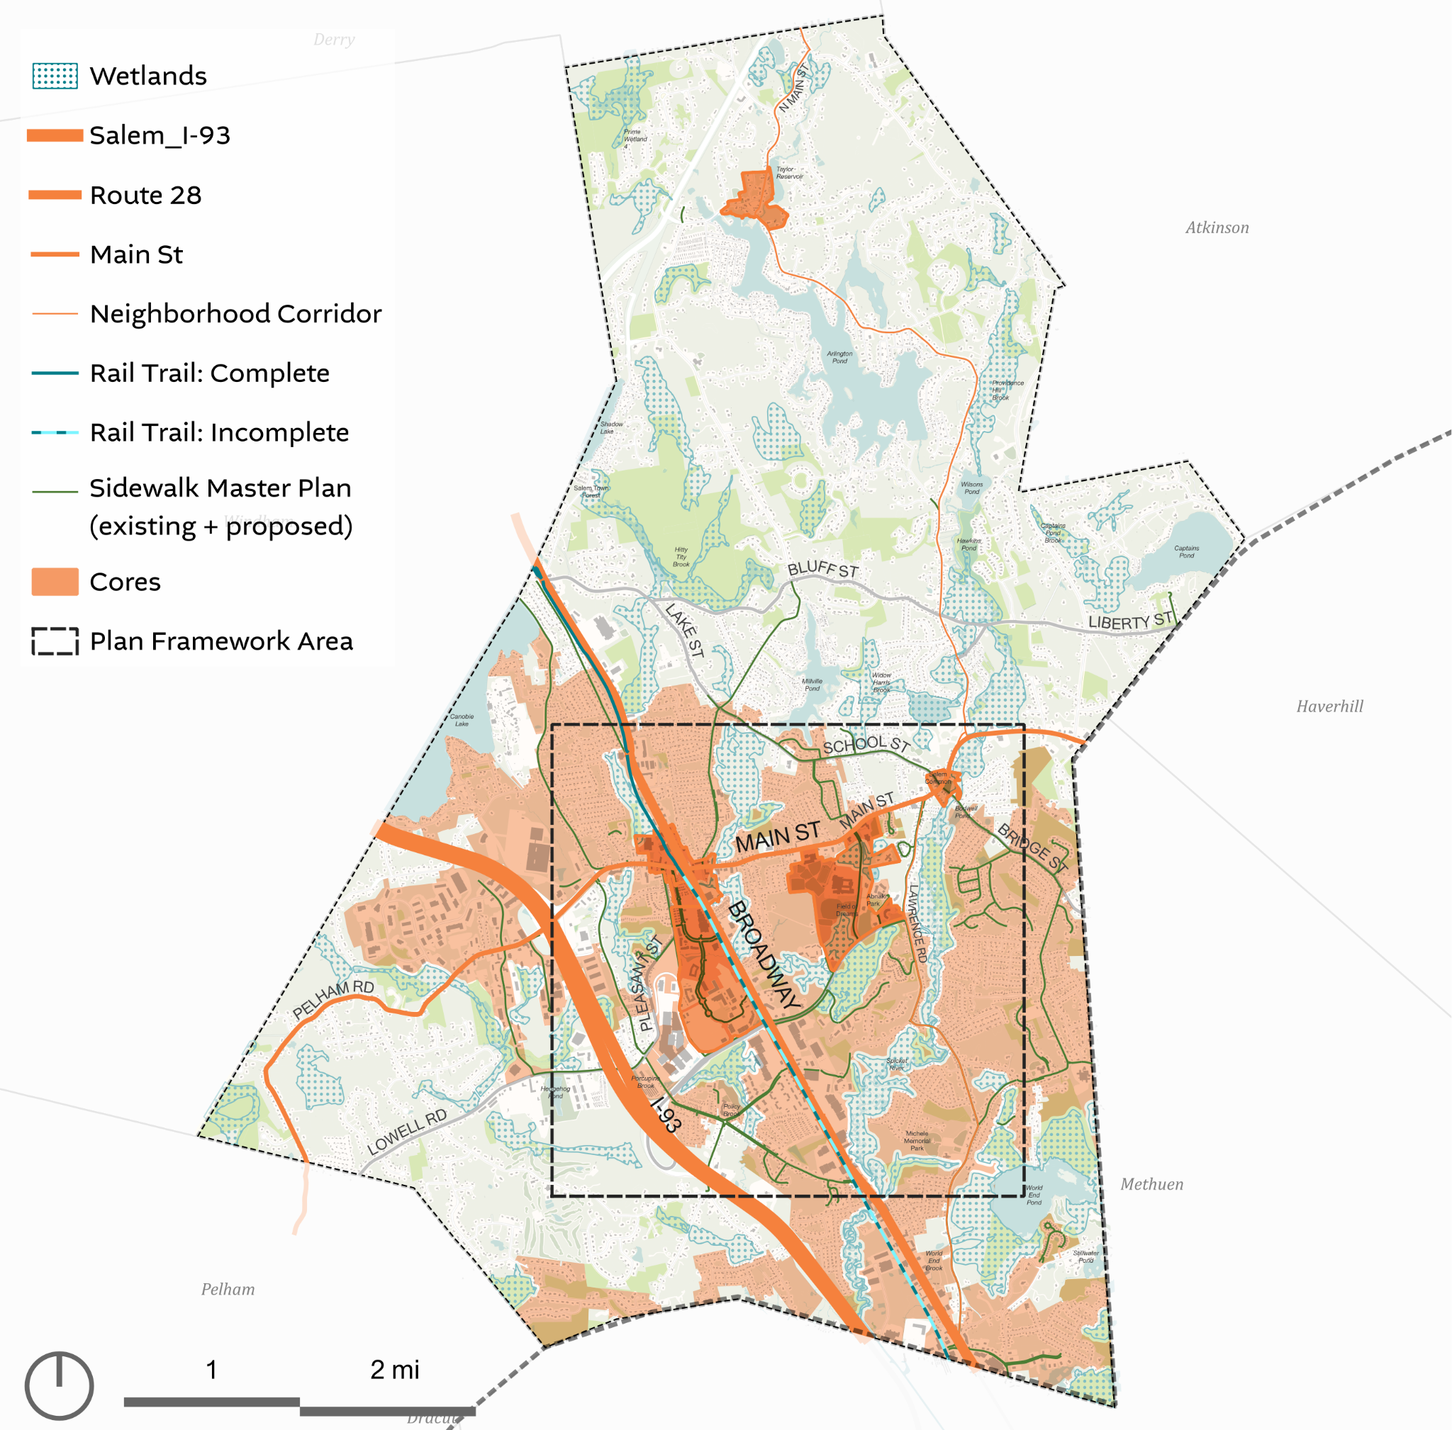
Early Analysis Insights
Where does Salem have development capacity?
Areas shown in light orange are the areas with development capacity.
These are areas with sewer infrastructure outside the 100ft wetland buffer.
Cores are shown in a darker orange to highlight the relationship of this area to places with community and commercial amenities:
Depot Village
Tuscan Village
Civic Center
Historic Town Center
North Salem Historic Town Center

Slide 9
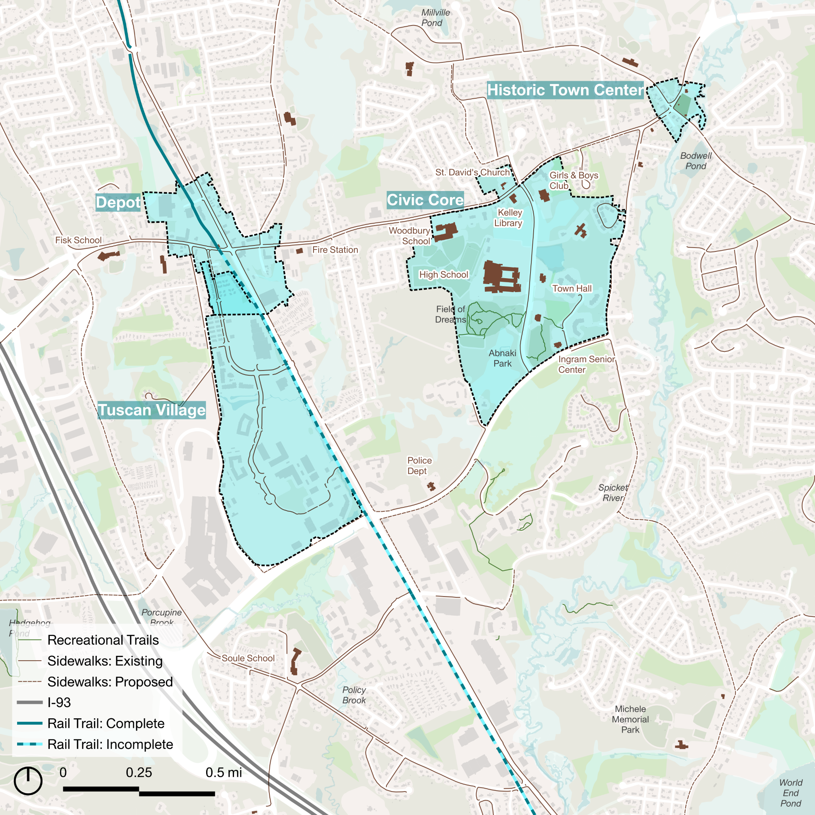
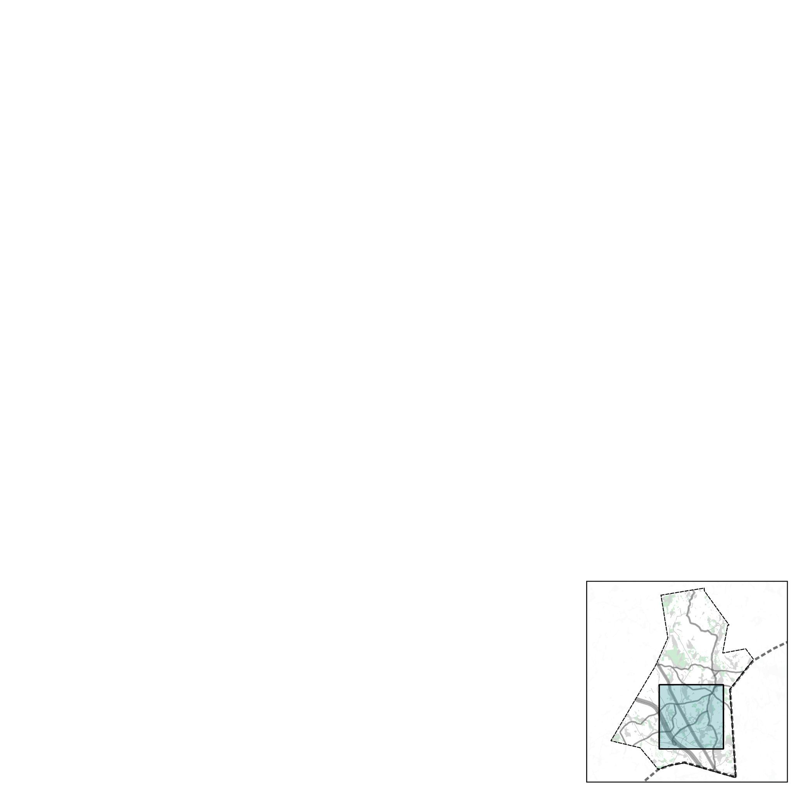
Getting the Development Balance Right
The gift and curse of a “hot market” for development
Salem is unique in the region in terms of both the diversity and volume of commercial and mixed-use development. This supports jobs and the tax base.
Recently, with Tuscan Village, the pace and intensity of development has picked up and is attracting more out-of-town interest.
Without a clear vision and policies from the Town about where development should occur, developers will seek out any larger underutilized parcel for redevelopment.
The importance of harnessing development pressure
In order to benefit from the development, Salem has to guide development to the places that are most aligned with community goals and initiatives.
For Salem, the best strategy to harness development for local benefit is to encourage thoughtful, compact development in the Town Center and along the RT-28 corridor. This reinforces existing infrastructure and amenities, while allowing rural development patterns and conservation to continue elsewhere in the town.

Slide 10
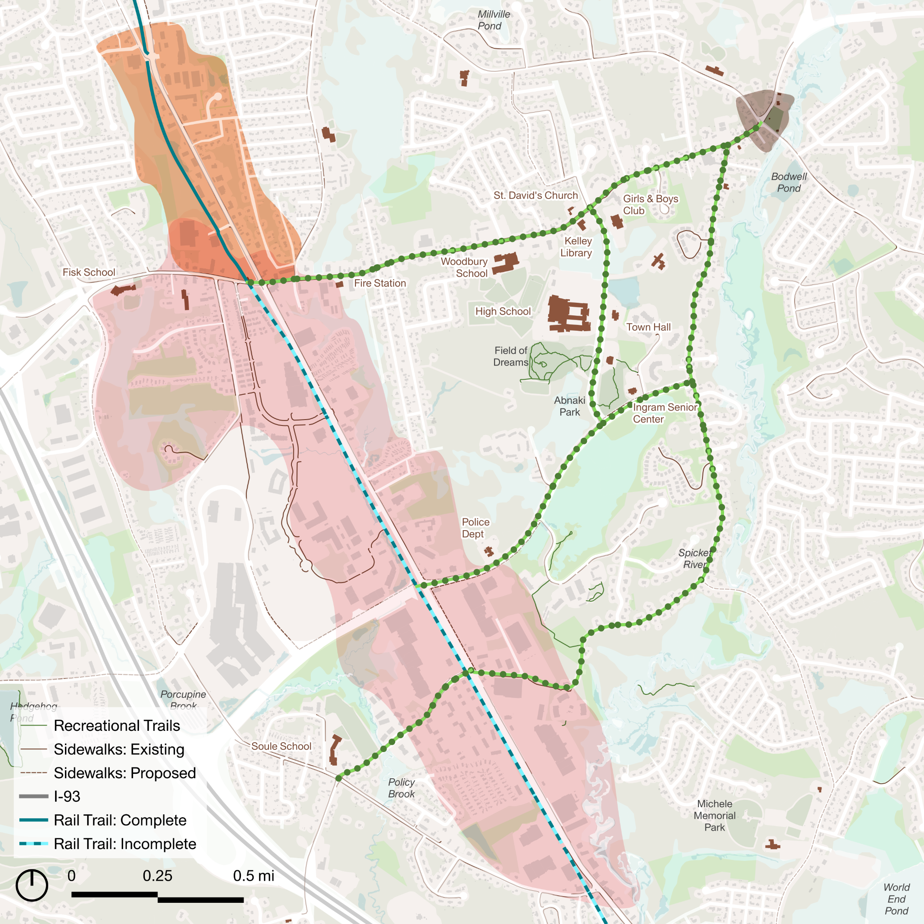
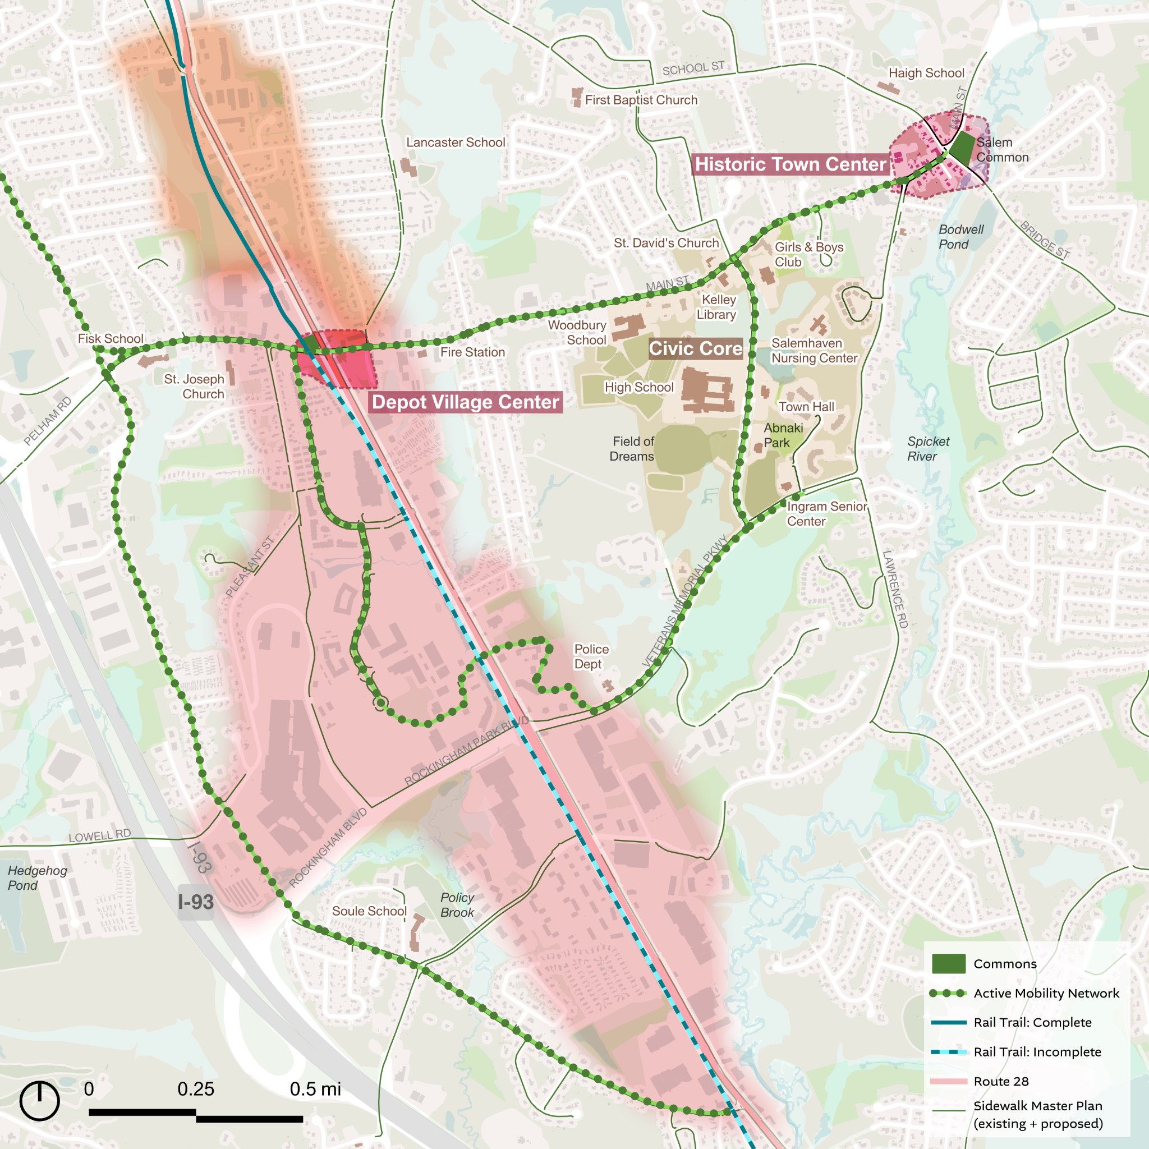
Plan Framework: cultivating a more vibrant and connected core
GATHERING SPACES
Historic Town Center
MIXED USE CORE
Invest in beautification and infrastructure to reinforce
community gathering spaces outside Tuscan Village.
Focus higher-density mixed-use development along the Broadway corridor (and deter elsewhere).
Geremonty Dr
Main St.
Lawrence Rd
Big Moves: Historic Town Center & Depot Village
Big Move: Expand boundaries and update the design standards of the Depot Village Overlay District.
Depot Village
TOWN CONNECTORS
Veterans Mem. Pkwy
Continue to invest in a safe sidewalk and bicycle infrastructure network connecting Salem public spaces, gathering places, and amenities.
MISSING MIDDLE EDGES
Expand housing options that match Salem household sizes
and budgets, especially near the Mixed Use Core.
Big Move: Complete and connect the town to the Salem Bicycle-Pedestrian Corridor (Rail Trail).
Big Move: Rezone for multi-family residential north of Depot.

Slide 11
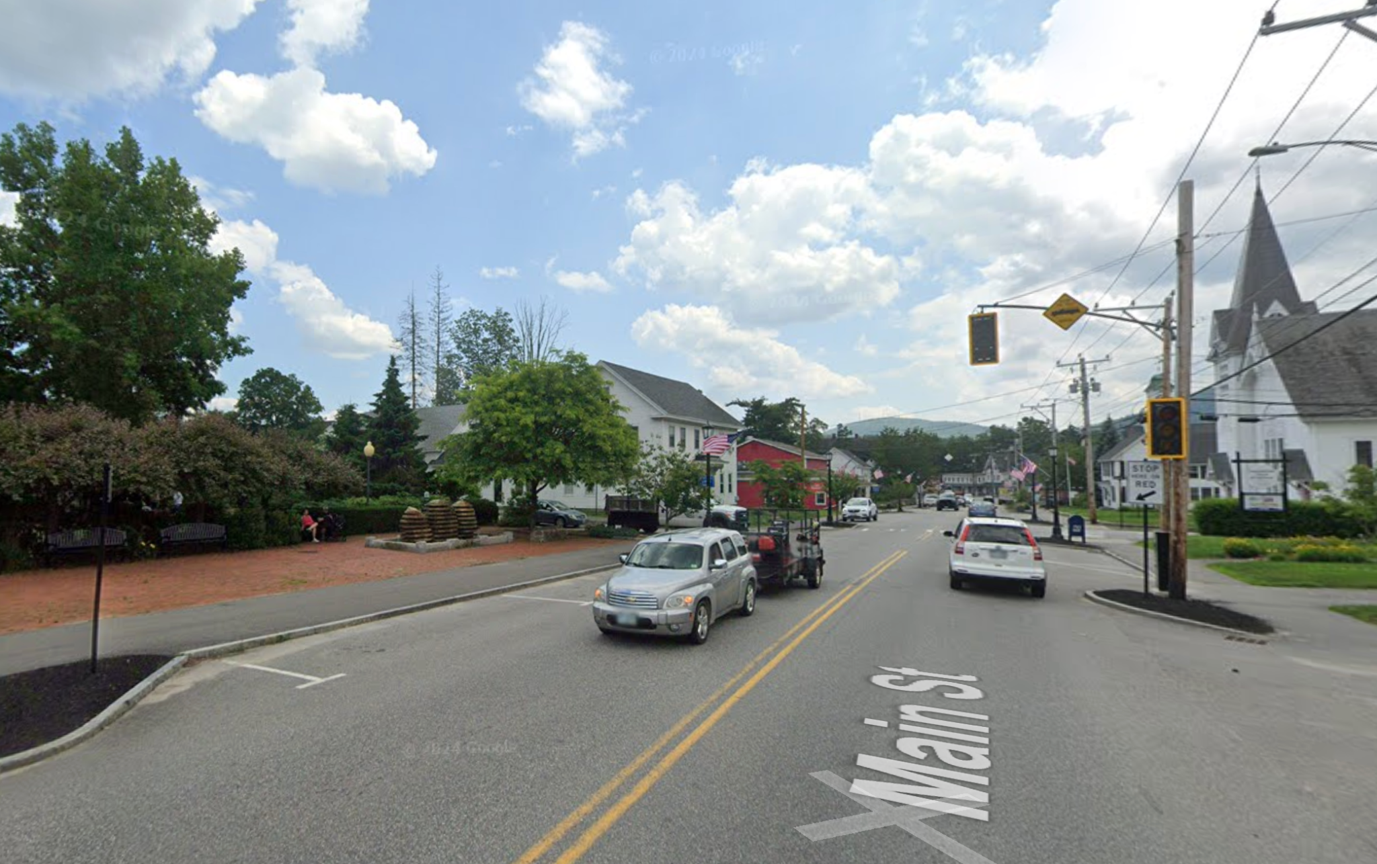
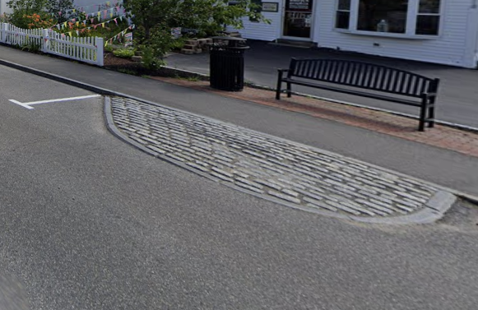
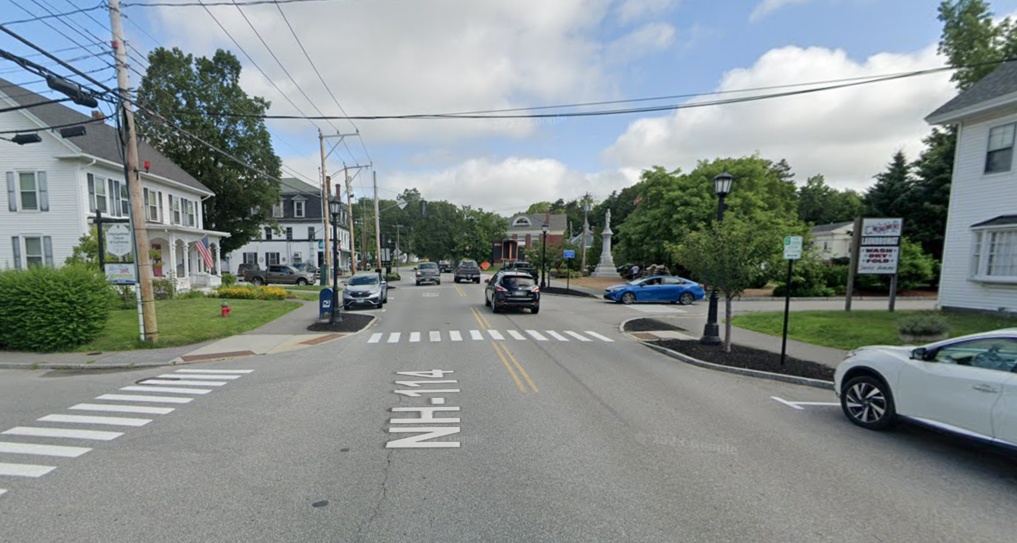
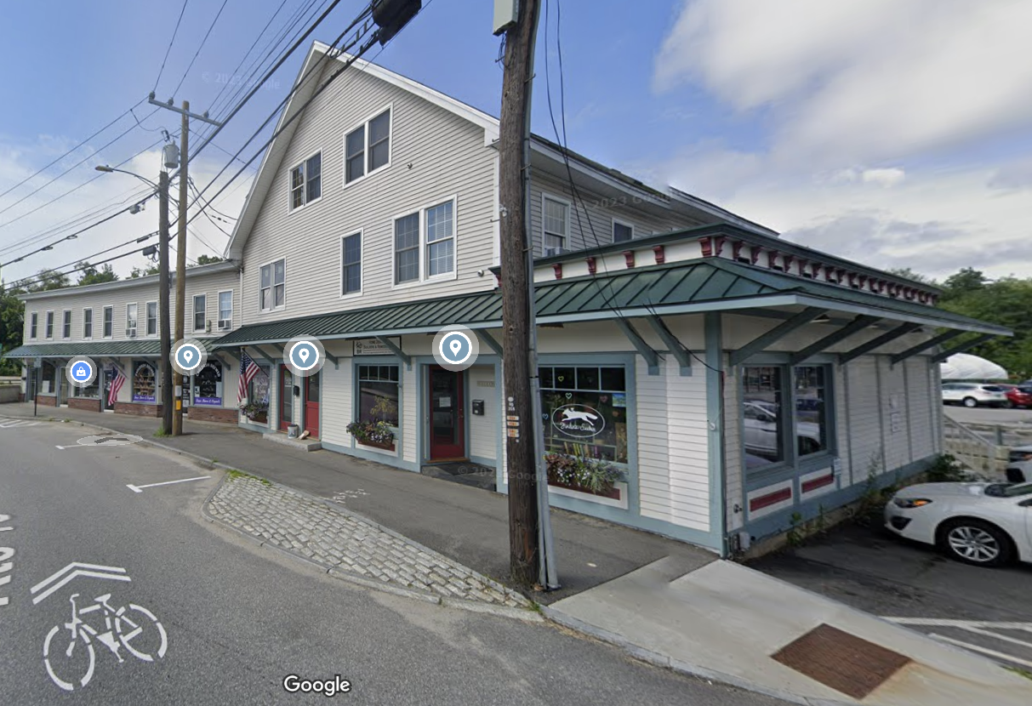
GATHERING SPACES
Granite cobblestone mountable medians & curb extensions increase pedestrian safety and improve appearance
Historic Town Center (Big Move)
Cultivate the Historic Town Center as a counterweight and complement to Tuscan Village.
This plan envisions a series of connected spaces that can support everything from somber recognition of Salem’s veterans to reflective quiet walks along the Spicket River and through old burial ground (including the Soul Stroll), to festive civic celebrations, farmers markets, and family-friendly recreation.
This can be achieved through:
Focused updates to the sidewalks and pathways connecting key destinations.
Light improvements to intersection and street design to improve pedestrian safety and appearance.
Incorporation of sensible event parking strategies to support larger gatherings.
Enhancements of a few strategic places that can promote increased use and programmatic activation of the civic spaces in and around Veterans Park / Salem Common.
Main St in Goffstown, NH between Elm & Mill Streets is an excellent precedent for Salem’s Historic Town Center, including street parking, curb extensions with trees, accessible pedestrian crossings and historically appropriate elements (light poles, red brick, granite cobblestones)

Slide 12
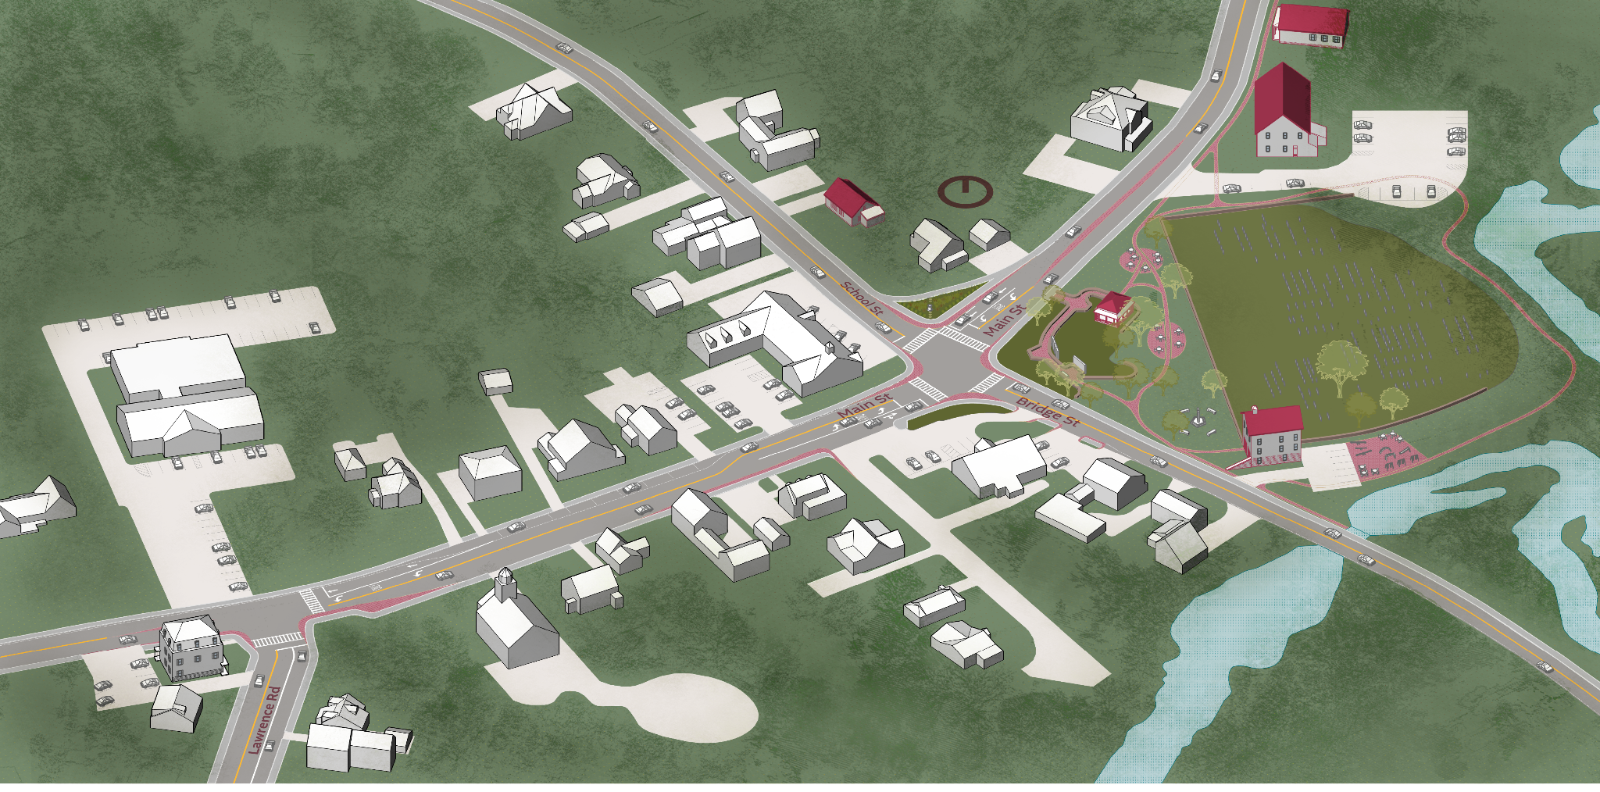
GATHERING SPACES
Historic Town Center (Big Move)
10
9
Cultivate the Historic Town Center as a counterweight and complement to Tuscan Village.
This plan envisions a series of connected spaces that can support everything from somber recognition of Salem’s veterans to reflective quiet walks along the Spicket River and through old burial ground (including the Soul Stroll), to festive civic celebrations, farmers markets, and family-friendly recreation.
This can be achieved through:
Focused updates to the sidewalks and pathways connecting key destinations.
Light improvements to intersection and street design to improve pedestrian safety and appearance.
Incorporation of sensible event parking strategies to support larger gatherings.
Enhancements of a few strategic places that can promote increased use and programmatic activation of the civic spaces in and around Veterans Park / Salem Common.
4
Main St
School St
5
Old Burial Ground
3
8
6
2
Bridge St
7
Main St
Spicket River
1
Lawrence Rd
Lawrence & Main Intersection Improvement: perpendicular intersection with planted curb extensions and shorter pedestrian crossings
Limited On-Street Parking: introduce parking where street width allows
School/Bridge & Main Intersection Improvement: remove right-turn slip lane from Main St to School St to expand memorial garden and increase pedestrian safety, introduce mountable curb extensions to create safer pedestrian crossings
Historic School
Gazebo & Veterans Memorials with new connecting pathway and small seating areas
Old Burial Ground, Historic Hose House & Playground
Restored Bridge with expanded sidewalk and brick/granite materials
Scenic Natural and Historic Loop Pathway
Historic Town Hall
Historic Library

Slide 13
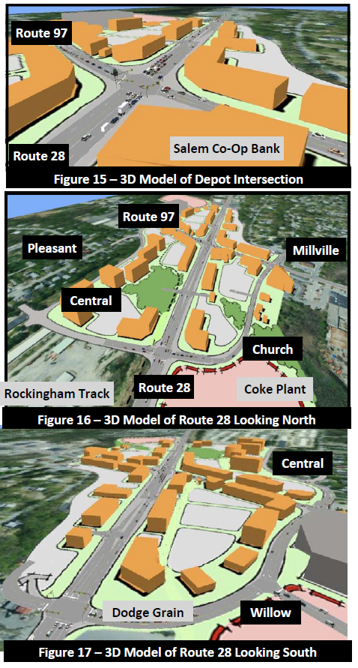
GATHERING SPACES
Depot Village (Big Move)
Continue to invest in Depot Village as a civic and recreational anchor.
To leverage and build on recent investments, the Town should continue to invest in Depot Village as a hub for Salem’s identity and recreational activities through:
Depot Village Master Plan
Strengthening Bike and Pedestrian Connections
Promote Programmatic Activation and Amenities
This builds on over a decade of planning and investment in the Depot Village, and works alongside the zoning recommended under the -Mixed Use Core- plan pillar.
2011 - the Depot Intersection Redevelopment Concept Plan introduced the current Depot Village Overlay District. This zoning allowed for density but has not resulted in any redevelopment yet. Requirements that may be preventing development include:
Ground floor commercial required for any development in district
Mixed use buildings shall be permitted up to 4 stories or 60 feet in height.
Maximum residential density shall be 12 units per acre.
2012 - the Route 28 Bike-Pedestrian Corridor report detailed an approach to implement a trail along Route 28 from Methuen, MA to Windham, NH. This has since been implemented in part and is detailed as a priority under the -Town Connectors- plan pillar.

Slide 14
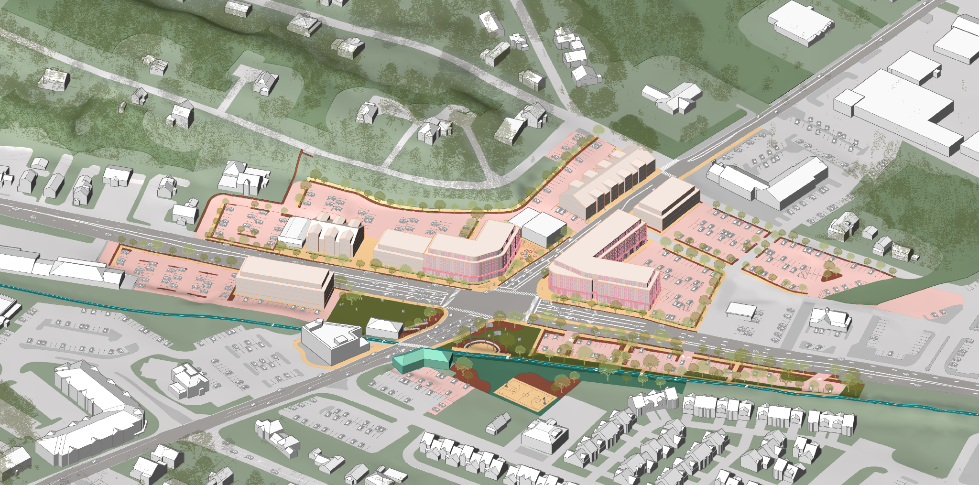
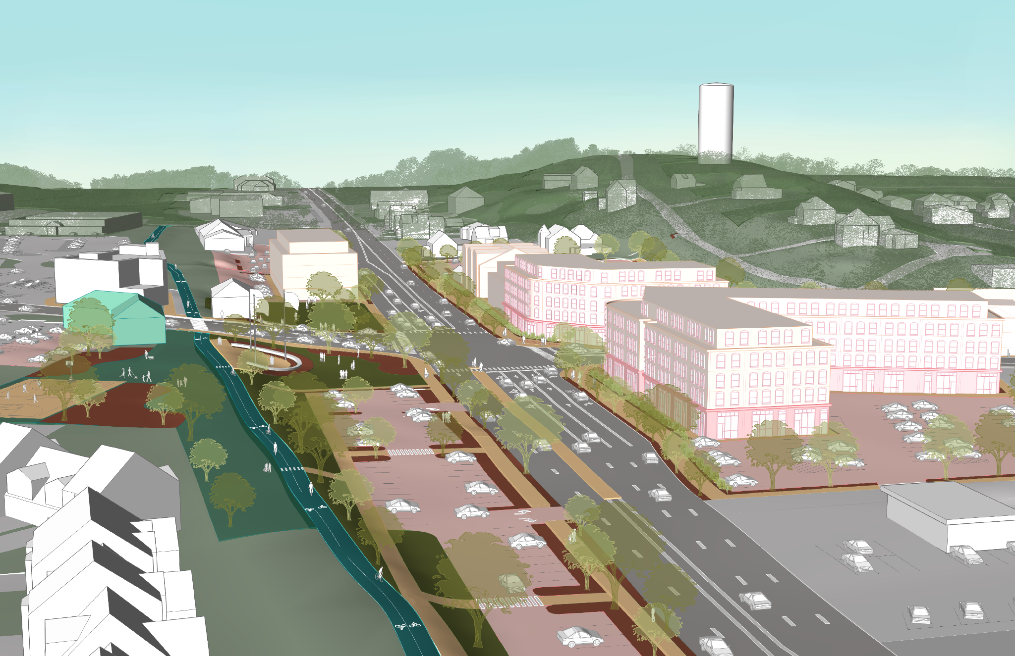
GATHERING SPACES
Depot Village (Big Move)
Continue to invest in Depot Village as a civic and recreational anchor.
To leverage and build on recent investments, the Town should continue to invest in Depot Village as a hub for Salem’s identity and recreational activities through:
Depot Village Master Plan
Strengthening bike and pedestrian connections
Promote programmatic activation and amenities
Street-activating mixed use development with consolidated parking
Main St
3-4 story multifamily residential provide scale transition to Main St
Broadway / Rt-28
Rail Trail
1
Improved pedestrian crossings and widened sidewalks with street tree plantings
Prioritize retention of existing commercial tenants through phased redevelopment
N
Historic Salem Depot Station Building
Enhanced trailhead and recreation hub with public parking, amenities, and veterans memorial

Slide 15
GATHERING SPACES
Supporting Strategies
Enhance and Expand Parks and Open Spaces
Continue to invest in recreational access to the Town’s rich natural resources, especially those mentioned in the Master Plan engagement (see the Recreation Wishlist).
There was broad interest in:
A linked network of quality parks, open spaces, and waterways specifically through bike trails.
Recreation-based spaces as a way to address the need for gathering spaces for residents to meet.
Beautification and access to natural resources such as public waterbodies.
Recreation Wishlist
Completion of the Rail Trail with dedicated parking
Water access and enhancements at Millville Lake, Arlington Pond, Spicket River, and Bodwell Pond
More playgrounds, fields, and courts (pickleball)
Dog park
Skate park
Splash pad and/or swimming pool
Hedgehog Park air quality, lighting, and amenities like benches and trash receptacles
Creative reuse of former Wastewater Treatment Plant
Parks geared toward passive recreation
Town Forest trail network
Educational signage on local wildlife
Public toilets
Enhanced lighting
In addition to the specific ideas listed in the recreation wishlist, the Town should explore two supplemental approaches to help fill out the network of recreation resources available to residents:
School Facility Shared Use: Explore ways to extend and promote shared use programming on school campuses outside of school hours for all residents, especially for playgrounds and athletic courts and fields.
Pocket Parks: Continue to identify and supply recreational amenities to neighborhood “pocket parks” similar to William Valentine Park to provide opportunities at low cost and in close proximity to residential neighborhoods. Innovative solutions like the “pocket park” concept help to broaden the community’s dwindling opportunities to maintain and enhance recreational, conservation, and open spaces.

Slide 16
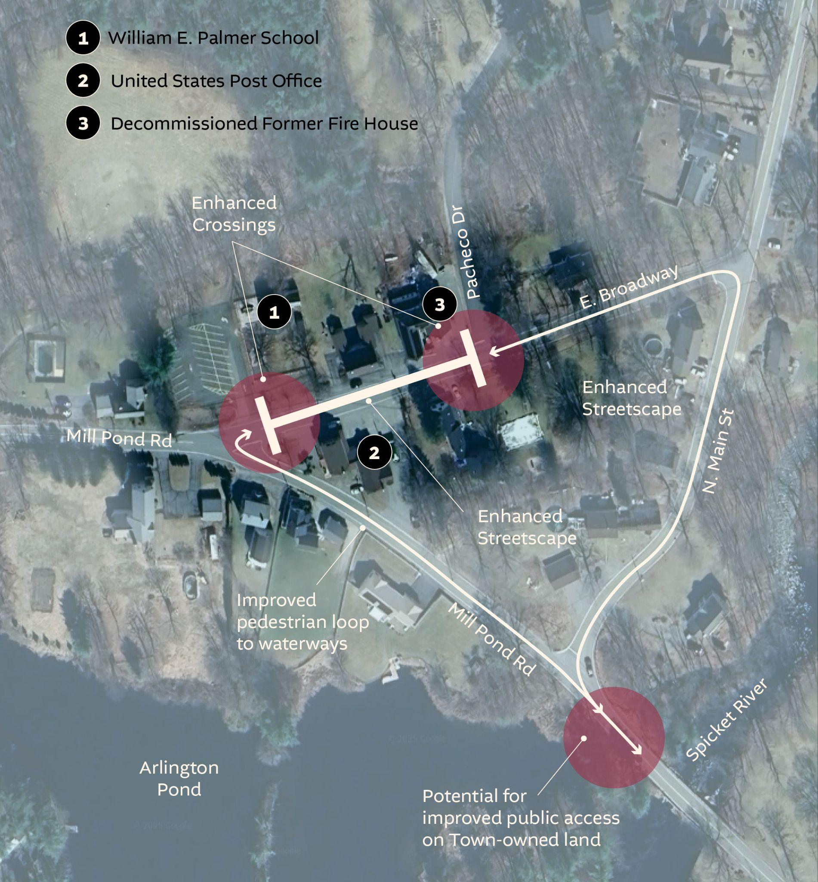
GATHERING SPACES
Supporting Strategies
Multi-Generational Consolidated Community Center & Services
Consider investing in a multi-generational, townwide community center that provides services for all ages. Since the building of the Ingram Senior Center in 2002, Salem has excelled in providing programming, gathering, recreational, and other opportunities to Salem’s seniors. It is worth exploring extending programming, a potential additional community center facility or space(s), and other recreational programming to residents of all ages, particularly teenagers and young families.
This facility and/or expanded service(s) could offer critical support, such as affordable daycare options, structured after-school programs, and extracurricular activities led by students’ interests. Creating an additional ‘third space’ for young families could foster greater connection as well as civic and community minded ideas and outcomes. It could also provide enrichment for seniors and residents of all ages, if the interaction of services is managed proactively.
North Salem Historic Town Center
Streetscape Improvements
Reinforce a sense of arrival and place at North Salem’s historic town center where East Broadway and Mill Pond Road converge near Arlington Pond. This should include intersection, sidewalk, and crossing enhancements to improve safety and enhance historic appearance at the intersections of East Broadway with Mill Pond Road and Pacheco Drive, and should improve pedestrian connections to William E Palmer school, Spicket River, and Arlington Pond.
Strategic Historic Preservation
Utilize Federal Historic Rehabilitation Tax Incentives for adaptive reuse and reinvestment in anchor historic buildings along Town Connectors, Salem Common, and North Salem Historic Town Center.

Slide 17
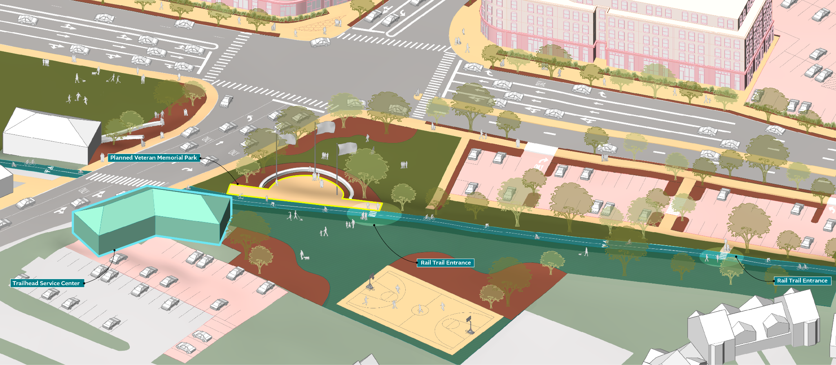
TOWN CONNECTORS
Big Move
Complete and connect the town to the Salem Bicycle-Pedestrian Corridor (Rail Trail).
Work to complete the Salem Bicycle-Pedestrian Corridor (Rail Trail) through the full length of its proposed alignment through Salem with improved, safe crossings of all vehicular roads, particularly Broadway (RT-28).
This should include pursuing strategic, grade-separated safe crossings at:
Rockingham Park Blvd (overpass)
Via Toscana (overpass and rear lot connection to Veterans Memorial Parkway)

Slide 18
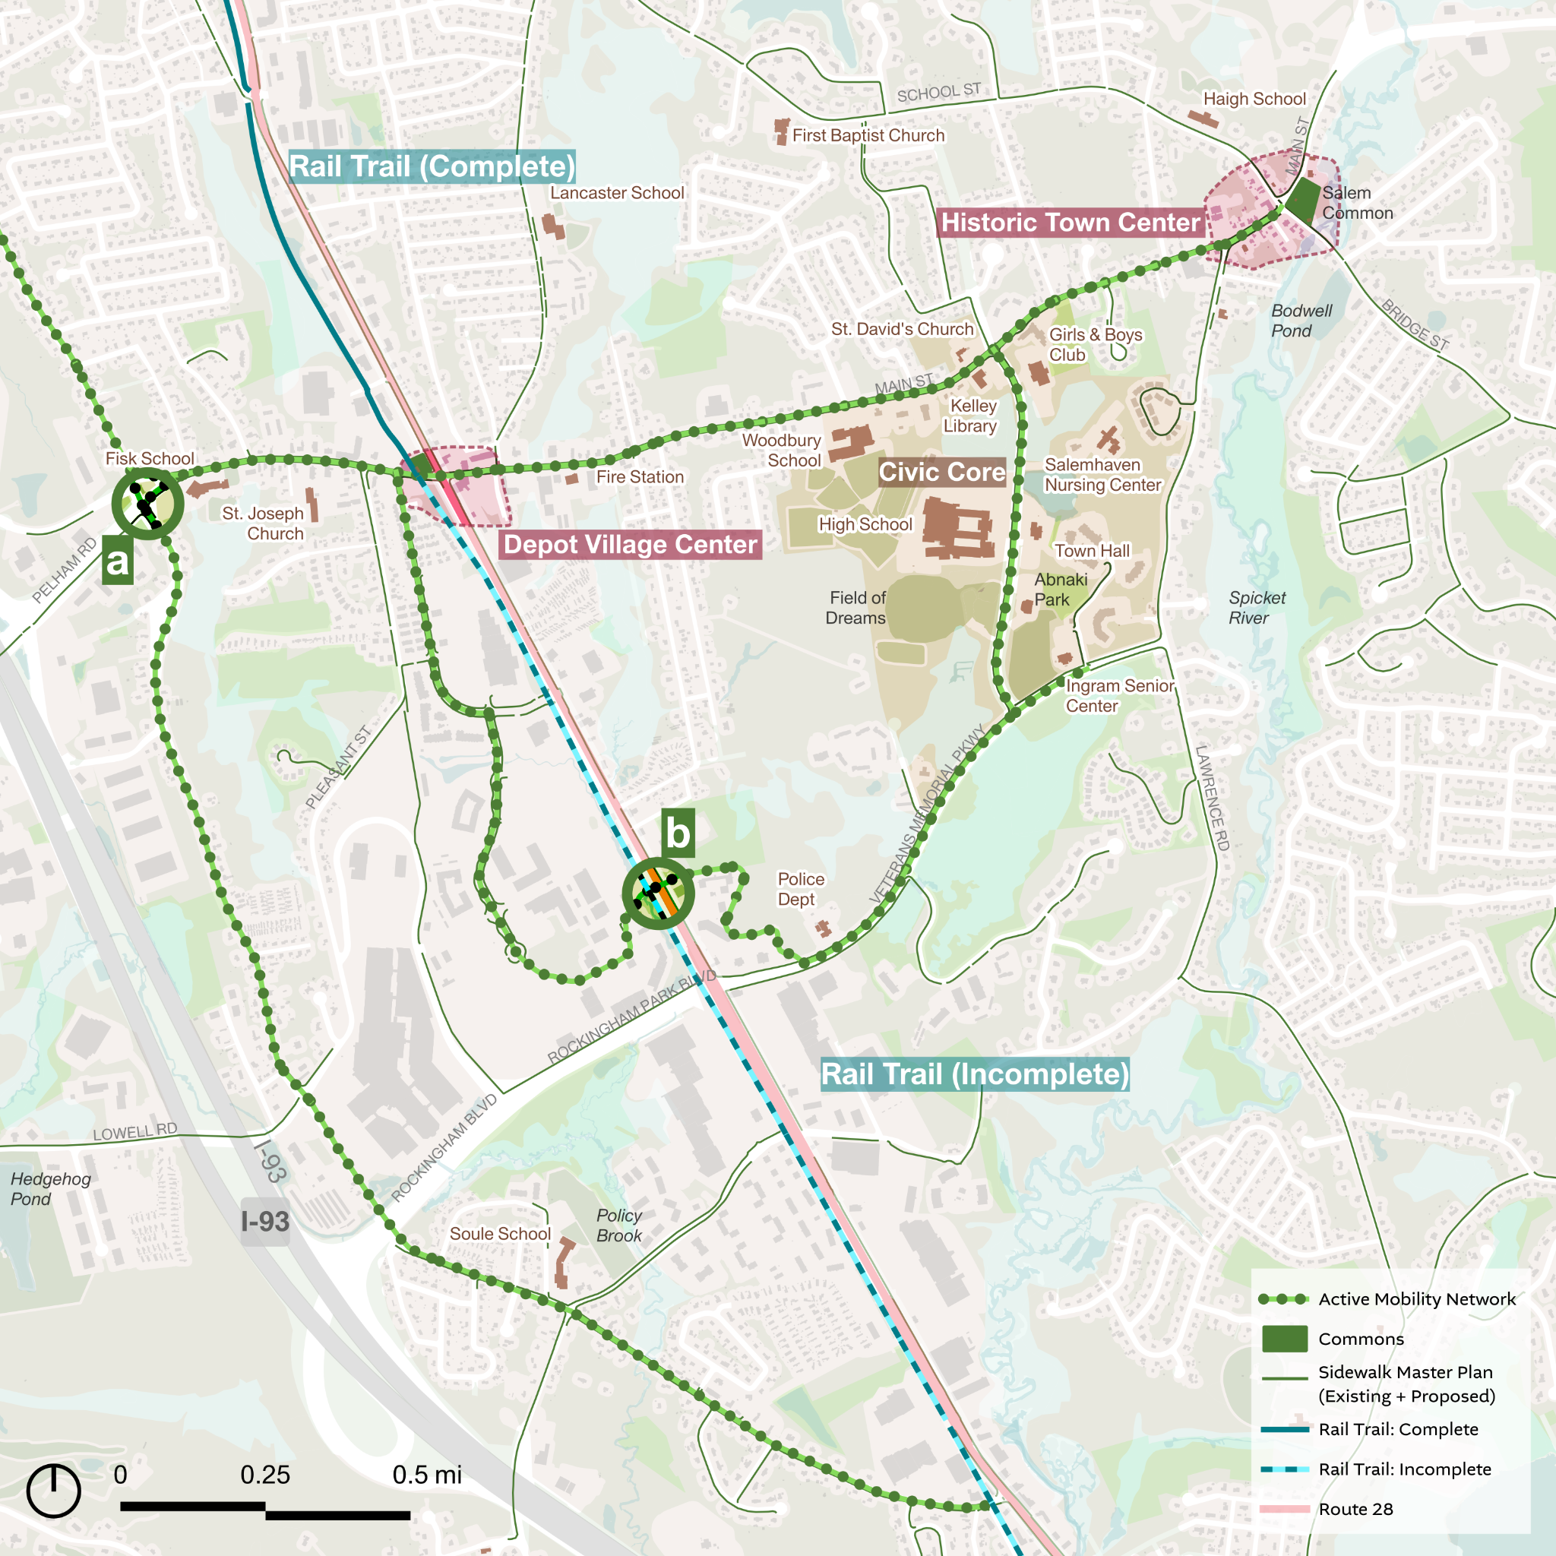
TOWN CONNECTORS
Supporting Strategy
1
Complete Priority Town Connector Network
This includes:
Main Street Corridor Engaging, comfortable and beautiful walking experience, focusing at ends and then filling in over time.
Multi-Use Path: Geremonty Drive & Veterans Memorial Parkway Enhance crosswalks and adapt the existing sidewalk to serve as a multi-use walking and bicycle path.
North-South Bicycle Connection: South Policy and Kelly Rd Narrow lanes and increase shoulder to encourage slower speeds and safer driver behavior so that residents have the option of bicycling to the Rail Trail and Tuscan Village. Work to secure additional ROW to permit future sidewalk or shoulder improvements that encourage a safer pedestrian experience.
1
2
Policy & Main
Via Toscana
3
2
Rockingham Park Blvd

Slide 19
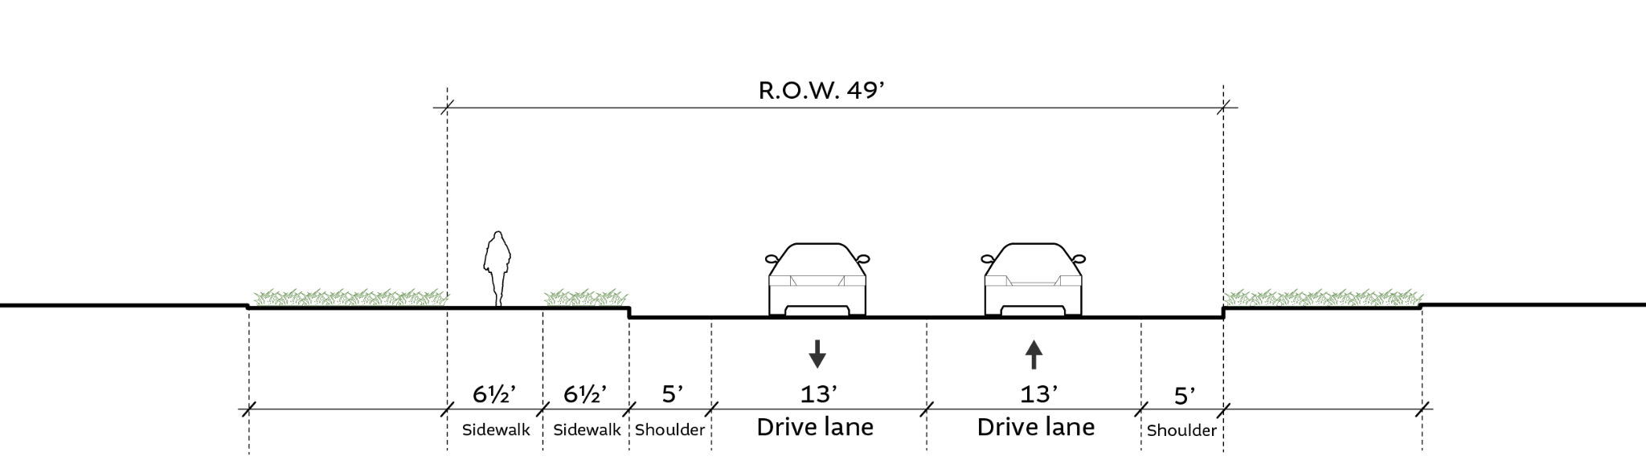
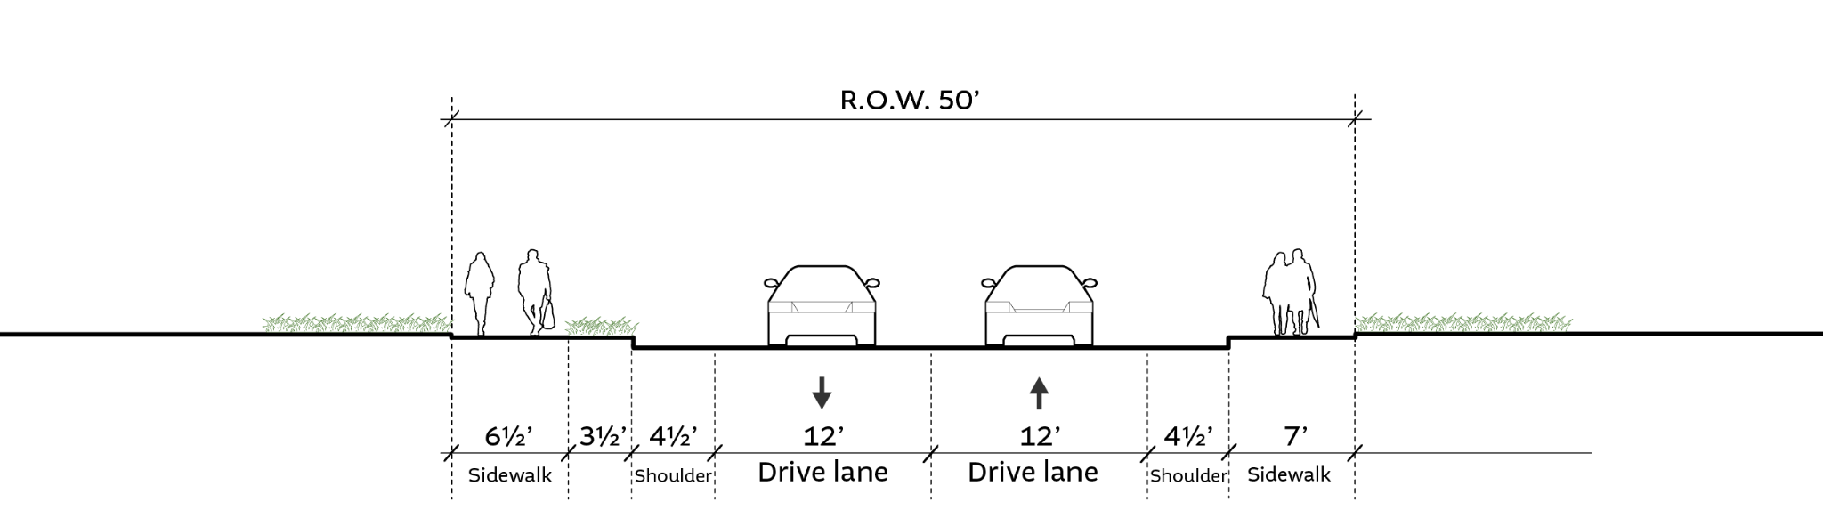
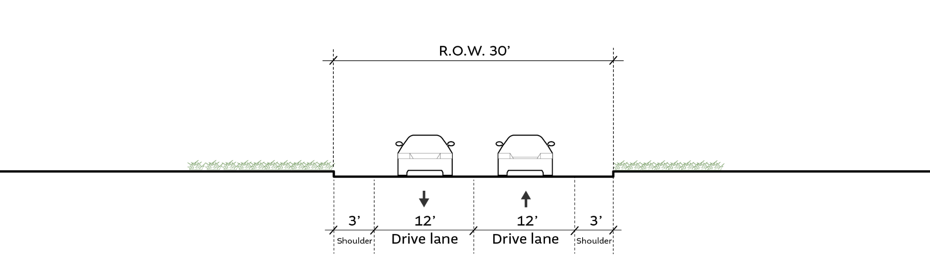
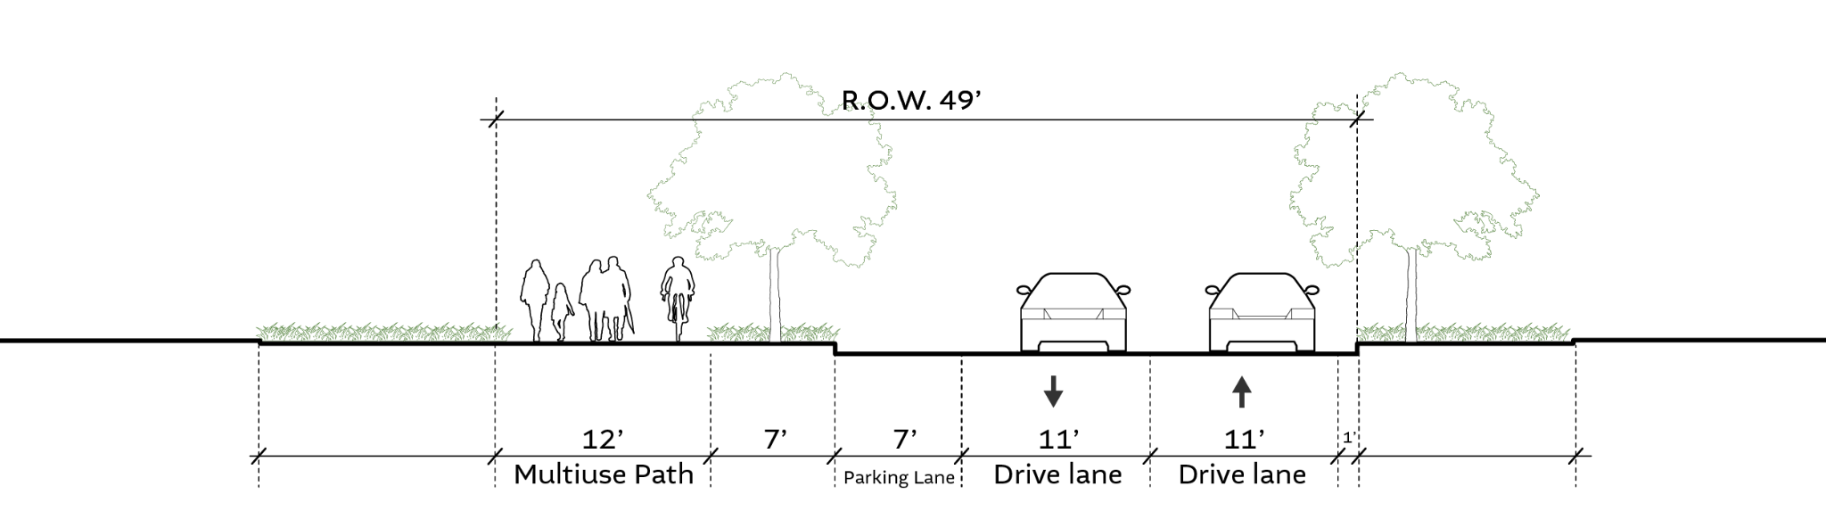
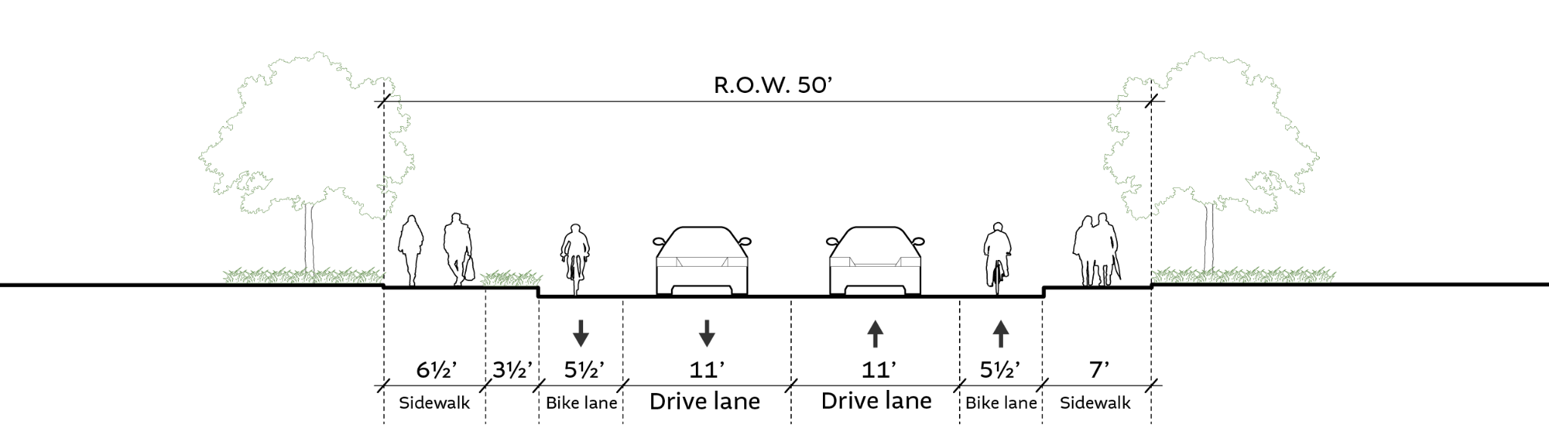
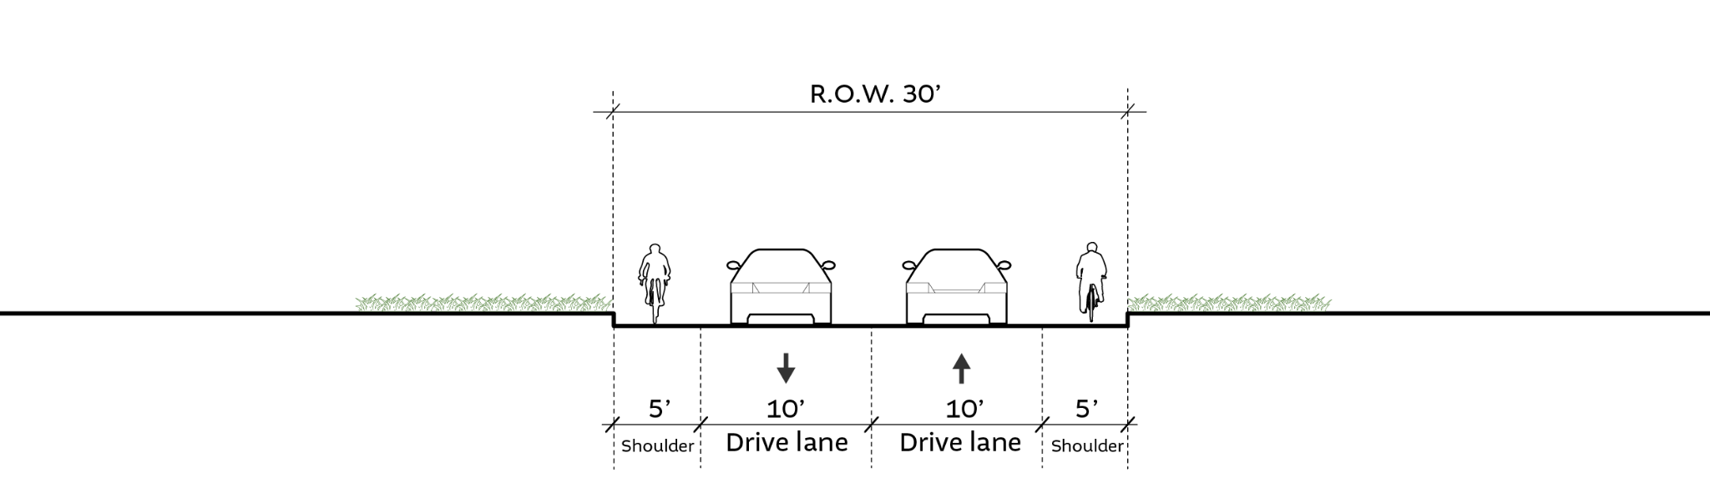
TOWN CONNECTORS
Supporting Strategy
Complete Priority Town Connector Network
Geremonty / Veterans
Existing
Main Street W of Rail Trail
Existing
South Policy
Existing
Proposed
Proposed
Proposed

Slide 20
TOWN CONNECTORS
Other Supporting Strategies
Create and Implement a Complete Streets Policy
Integrate the Sidewalk Master Plan with bicycle infrastructure considerations to form a new “complete streets” policy in alignment with this plan’s four pillars and the priority Town Connectors framework described above. This policy should address all areas of town and should embed complete streets improvements into annual street upgrades including repaving, reconstruction and restriping.
Main action items are:
Update and implement Sidewalk Master Plan
Incorporate bicycle and walkability infrastructure into road improvements wherever feasible
Provide Dedicated Parking for Rail Trail on Broadway (Rt-28).
Provide dedicated parking for the Rail Trail on publicly owned lots in the Depot District and partner with Rail Trail-adjacent businesses across from Duffy Ave to open parking lots for Rail Trail visitors.
Work with businesses adjacent to Rail Trail across from Duffy Ave (TSR Hockey, Highline Auto Sales, Title Cash, Amore Pizza, and Taco Bell) to open parking lots for Rail Trail visitors.
Provide dedicated parking for Rail Trail on publicly owned lots in the Depot District.
Note: This recommendation is closely related to the Depot Village recommendations under the -Gathering Spaces- plan pillar.
Develop Town Gateway & Wayfinding Program
Invest in updated, unified signage to welcome people and help them find their way. This will reinforce the Town Center(s) and Town Connectors for visitors and residents alike.
Note This recommendation is closely related to and should be coordinated with the Historic Town Center and Depot Village recommendations under the -Gathering Spaces- plan pillar.
Explore Feasibility of Enhanced Transit Service
Pursue grant funding and explore partnerships with CART and major anchor employers, property owners, and investors to create a focused transit service to connect key Town amenities (e.g. Tuscan Village, Historic Town Center, Civic Core, Senior Center, Healthcare) for all residents. This should build on the existing CART “shopper shuttle” and on-demand service, and integrate with the Boston Express Terminal at Exit 2 and existing Salem Express service.

Slide 21
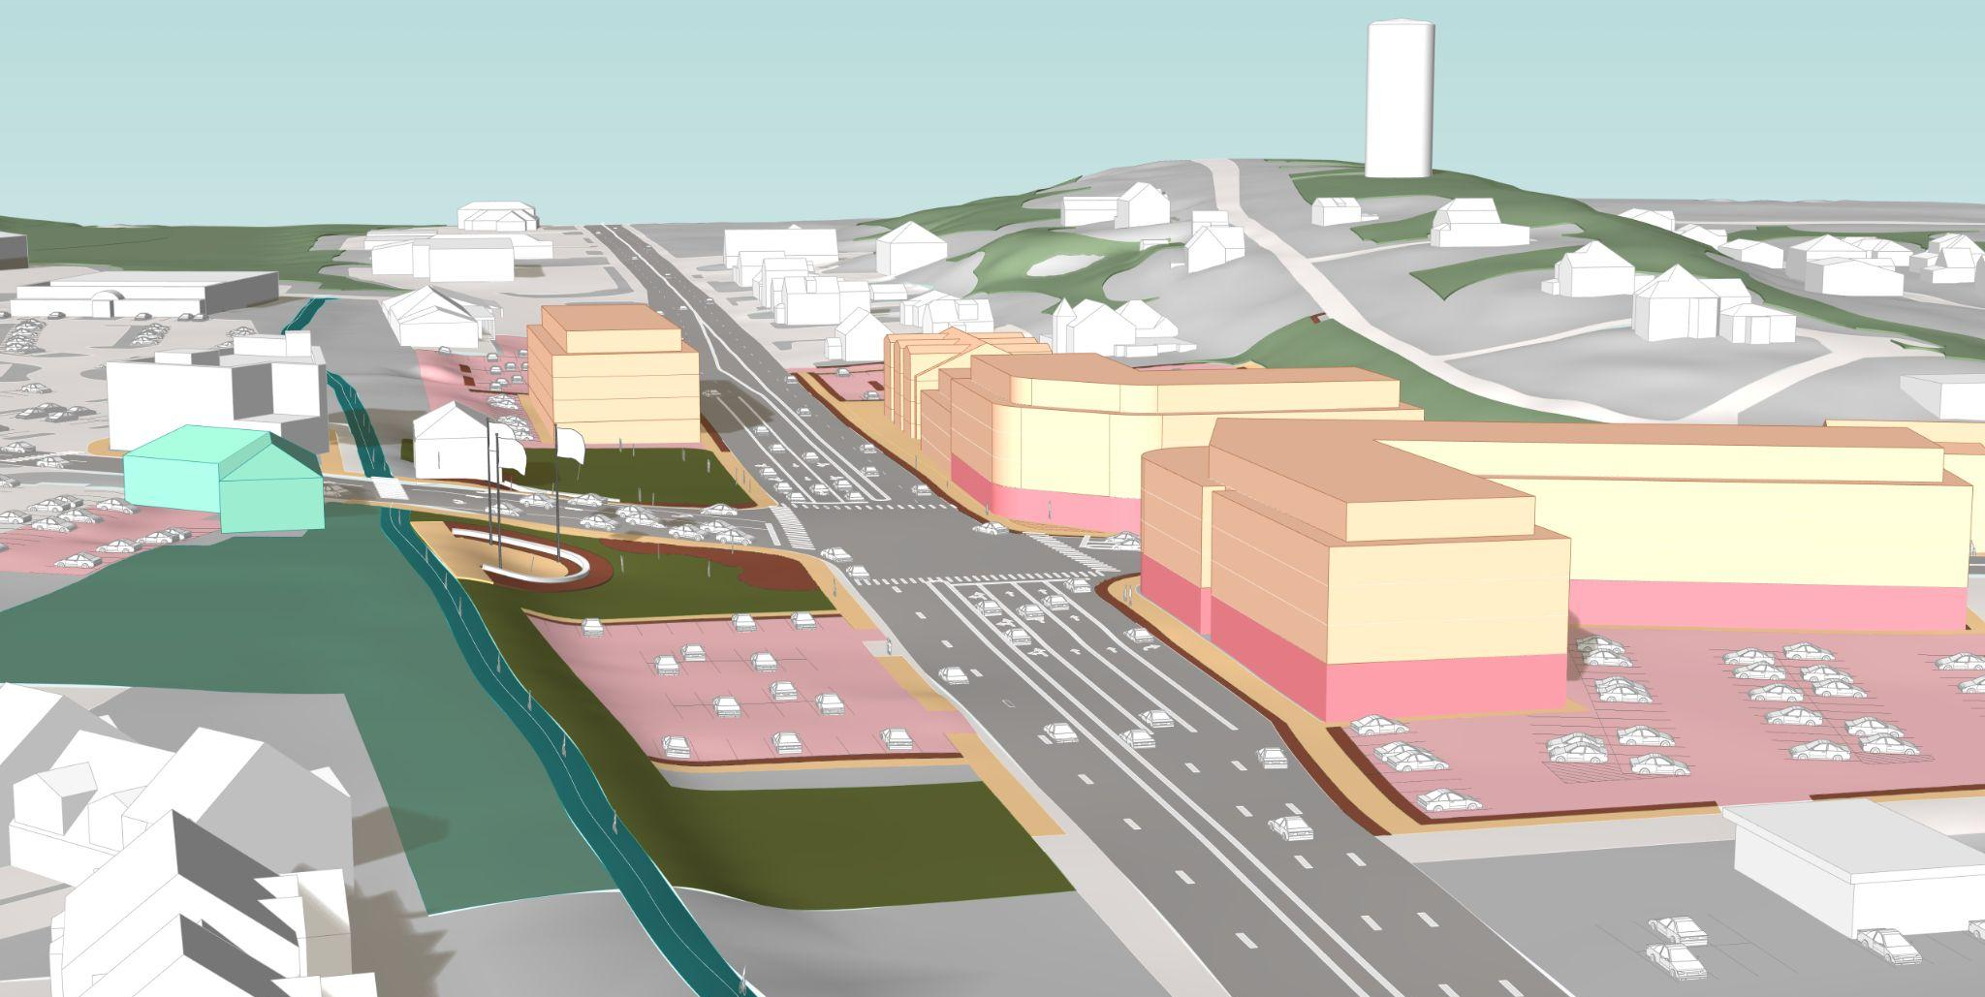
MIXED USE CORE
Example of 4 story development scale on Broadway with workforce housing
Transitional height from Depot intersection to existing building scale along N Broadway (2.5 stories)
Big Move
Expand boundaries and update the use and design standards of the Depot Village Overlay District to encourage walkable mixed use development and workforce housing along Broadway.
By-Right: 3 story max, allowing residential only
Bonus: two story bonus (up to 5 stories max) if both ground floor retail and workforce housing is delivered, one story bonus (4 stories max) if only one is included. To qualify for these bonuses the development must:
Dedicate at least 33% of the ground floor area and 80% of the street frontage to commercial, street-activating uses
Deliver at least 12.5% workforce housing, using Variety Standard
Minor Updates to Design & Parking Requirements (e.g. for parking - reduced minimums, consider maximums)
Salem
Depot
Station
Broadway / Rt-28
Rail Trail
Note: This recommendation is integrated with the Workforce Housing Variety Standard recommendation under the -Missing Middle Edges- plan pillar.
Example of 5 story development scale on Broadway with commercial ground floor + workforce housing

Slide 22
MIXED USE CORE
Supporting Strategies
Promote Neighborhood-Scale Mixed-Use Development to Activate Main Street
Leverage zoning and programmatic support to activate Main Street as a more walkable and intimately scaled corridor connecting the “new” commercial Salem along Broadway to the historic and civic anchors of small town Salem. To accomplish this, it is critical that Main Street is a supportive environment for small businesses and diverse smaller-scale housing.
Zoning: create a unified corridor zoning along Main Street from that allows for a wider range of uses.
Programmatic: technical assistance and small grant programs that support the incubation of small businesses and restoration of historic residential properties.
Start out by focusing in the immediate vicinity of the Depot and the Historic Town Center, and then over time work to connect these bookends to the concentration of civic uses along Geremonty Drive.
Transition Support for Existing and New Businesses
Proactively develop business support technical assistance and grant programs focused on two pain points in the redevelopment process:
Help existing businesses displaced by redevelopment to find alternative locations in Salem, and
Help reduce the cost for the first generation tenants of newly built commercial spaces by providing targeted help for the fit-out of core and shell commercial spaces that need to be built out with finish materials appropriate to the desired type of commercial tenant.
Tie Public Amenities and Infrastructure Investment to Development
Within the expanded Depot Village Overlay District, identify projects that would provide the amenities, services, and infrastructure to support this level of density, and tie development approvals to delivery of these public benefits.
Cultivate Job-Rich Commercial and Industrial Development Along I-93
Continue to monitor for anticipated turnover and vacancies in car-oriented commercial areas and encourage redevelopment that prioritizes living-wage jobs and local services and amenities. This should include but not be limited to the existing Business Innovation District Overlay.
Continue to Maintain and Refine Business Tax Incentives
Continue to encourage economic development, a healthy commercial tax base, and thriving businesses through the maintenance and refinement of the Commercial and Industrial Property Tax Incentive (RSA 72:81) and Economic Revitalization Zones (ERZs).

Slide 23

MISSING MIDDLE EDGES
Example of 4 story development scale on Broadway with workforce housing
Big Move
Rezone for multi-family residential north of Depot.
Update zoning along Broadway north of Depot to encourage multi-family housing options that are compatible with the existing scale of residences surrounding the corridor.
By-Right: 3 stories max, allow/encourage small multifamily housing typologies based on siting (Rt-28/Depot vs. Side Street vs. Cul-de-Sac)
Bonus: two story bonus (up to 5 stories max) if workforce housing is delivered
12.5% workforce housing (using Variety Standard) would be required to qualify for bonus
Salem
Depot
Station
Broadway / Rt-28
Rail Trail
Note: This recommendation is integrated with the Workforce Housing Variety Standard recommendation under the -Missing Middle Edges- plan pillar.
Example of 5 story development scale on Broadway with commercial ground floor + workforce housing

Slide 24
MISSING MIDDLE EDGES
Supporting Strategies
Workforce Housing Variety Standard
Introduce a variety standard to Salem’s existing Workforce Housing Ordinance (2021) for all new multifamily housing projects which exceed the density allowed in the underlying zoning district.
Current Requirement:
At least 10% of units shall be affordable to households at or below 60% AMI
Suggested Requirement:
AMI = area median income for Lawrence, MA PMSA - NH Portion, as reported by the U.S. Department of Housing and Urban Development.
Affordable = housing costs are no more than 30% of gross household income
Enable Missing Middle Housing Types in Town Center Walkshed
Encourage missing middle housing types like duplexes, townhouses, and 4-12 unit courtyard apartments on larger parcels with sewer access, and especially in areas within a 15 minute walk of the Depot, Historic Town Center, and/or the Civic Core.
These areas should also be considered for more flexible parcel subdivision rules and/or site plan regulations that encourage condominium standards that would allow smaller single family and cottage cluster development typologies that are ideal for “starter homes” and seniors looking to downsize and age in place.
Promote Accessory Dwelling Units (ADUs) Townwide
Promote Accessory Dwelling Units (ADUs) townwide through policy and programmatic efforts, with a focus on how ADUs can help to meet housing needs for the local workforce and seniors aging in place.
Ideas include fine-tuning zoning as well as enhancing the current ADU how-to guide and pair with a support program that includes owner-occupant financing strategies focused on young families and seniors aging in place.
Establish a State Housing Opportunity Zone in Salem
Establish a Housing Opportunity Zone, as defined in the 2021 State Housing Opportunity Zone legislation, that encompasses the Mixed Use Core Zone, Missing Middle Edges Zone, and Town Center Walkshed in order to make market delivery of workforce housing more financially viable.
# Units | % Affordable | 60% AMI | 80% AMI
0-7 | 0% | n/a | n/a
8-19 | 10% | 10% | 0%
20+ | 12.5% | 7.5% | 5%

Slide 25
Planning Board Comments & Discussion

Slide 26
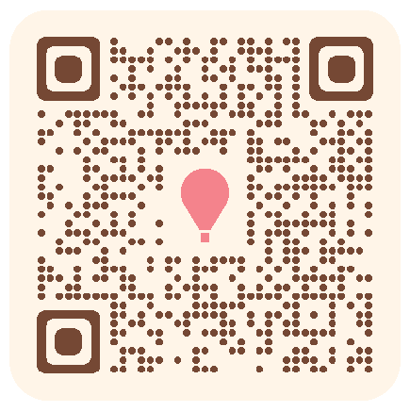
Next Steps
Draft Plan Public Comment The full draft plan is available for public comment as of today. It will be open for comment for approximately one month, followed by a 2 week revision period. We expect Public Comment to close 3/19 Visit the website to review the Draft Plan and share your comment using the form.
Planning Board Adoption Meeting Early/Mid April
Plan Website
December
January
February
March
April
Steering Committee
Planning Board
Adoption
Target
Public Comment
Revisions

Slide 27
Thank You!

