Slide 1
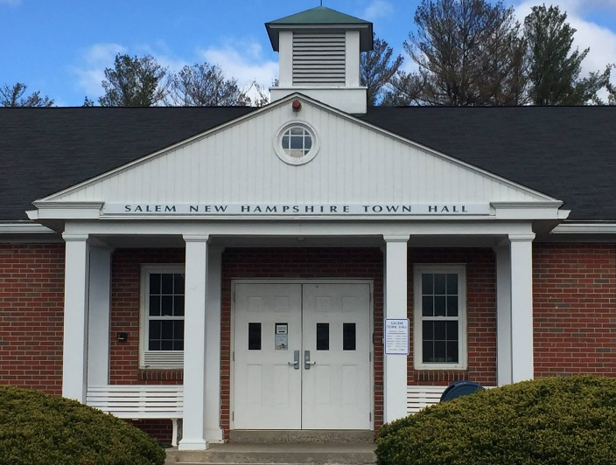
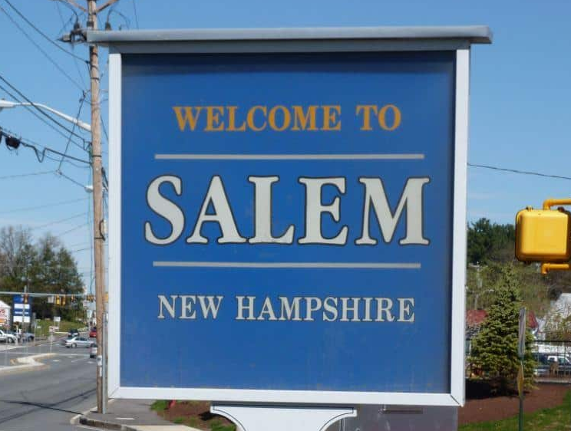
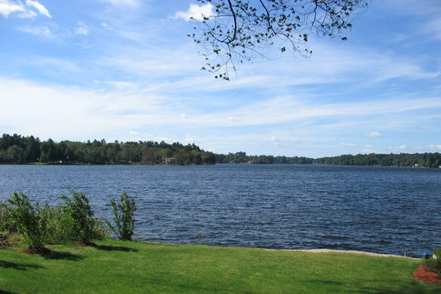


Image: Facebook.com
Image: Facebook.com
Image: Tripadvisor.com
Stormwater Ordinance Overview
Salem, New Hampshire
September 25, 2023

Slide 2
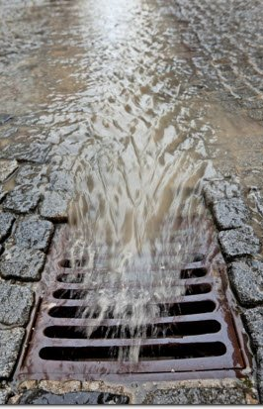
AGENDA
01
Background
02
Impairments in Salem
03
Stormwater Ordinance Overview

Slide 3
01
Background

Slide 4
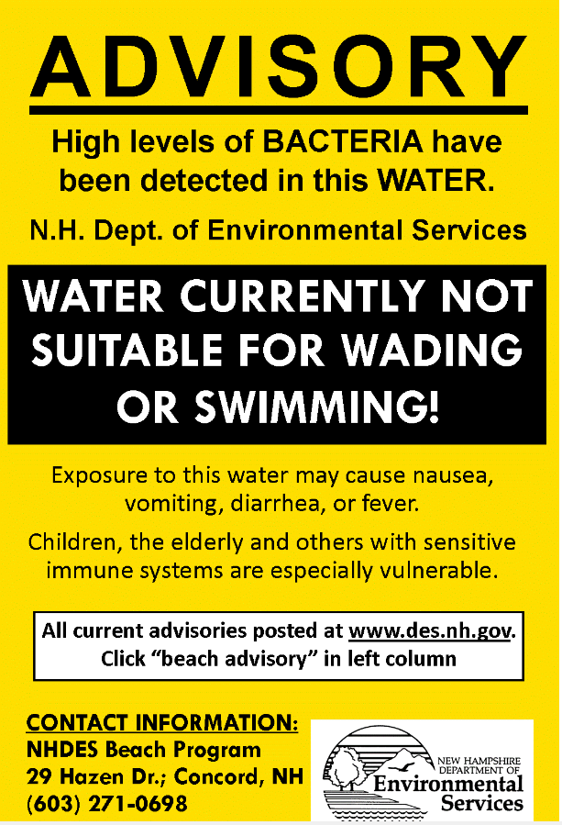
Permit Intent
What is the MS4 Permit?
01
Stormwater is the #1 Cause of Water Quality Impairments in New Hampshire
Improve Water Quality
Restore Designated Uses
Eliminate Beach Advisories

Slide 5
02
Impairments in Salem

Slide 6
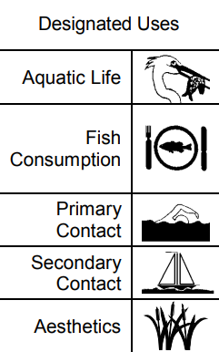
Impairments in Salem
02
Impaired Waters
Impaired waters are defined federally as waterbodies that do not meet designated uses or water quality standards.
Designated uses include the following:
Primary Contact Recreation (swimming)
Secondary Contract Recreation (fishing, boating)
Fish Consumption
Aquatic Life Habitat
Aesthetics
Note: Not all designated uses apply to all waterbodies

Slide 7
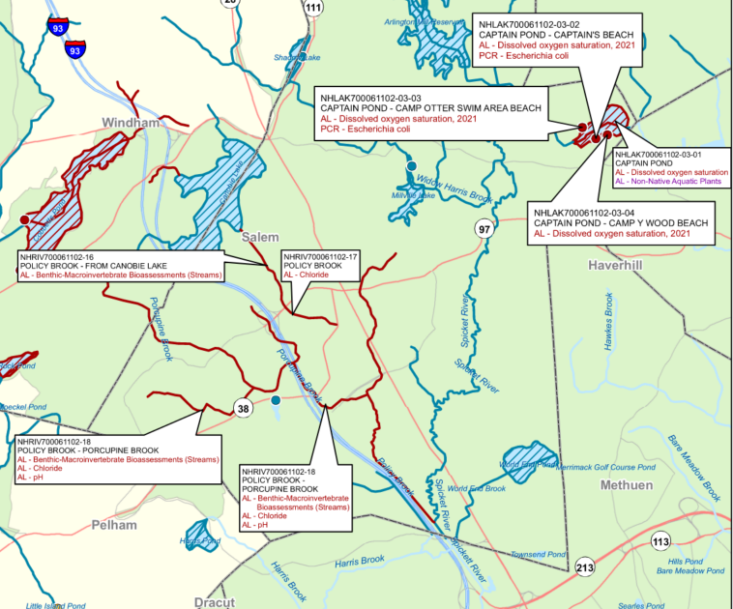
Impairments in Salem
02
Impaired Waters in Salem
Bacteria
Captains Pond
Arlington Mill Reservoir
Millville Lake
Hedgehog Pond
Shadow Lake
Chloride
Policy-Porcupine Brook
Policy Brook
Unnamed Tributary to Harris Brook
Phosphorus
Captains Pond
Iron
Policy Brook
Shadow Lake Newly Added

Slide 8


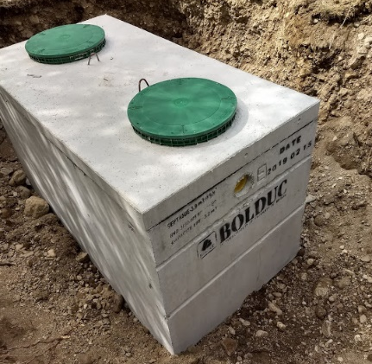
Impairments in Salem
02
Bacteria-Related Impairments – Common Sources
Improper Disposal of Pet Waste
Geese & Waterfowl Droppings
Septic System Failures
Sewer System Defects
Image Source: NHDES, Google Images

Slide 9
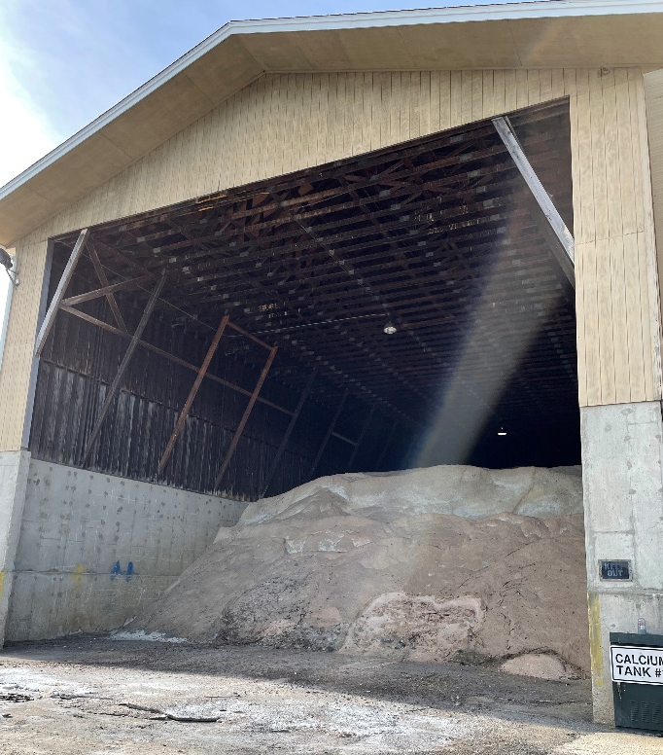
Impairments in Salem
02
Chloride Impairment – Common Sources
Winter Road Maintenance (salt)
Storage and Maintenance of Deicing Materials
Salem Salt Barn. Deicing material is required to be stored in covered locations under the 2017 NH MS4 Permit.

Slide 10
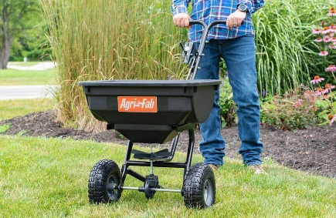


Impairments in Salem
02
Phosphorus Impairments – Common Sources
Fertilizer Use
Improper Disposal of Grass Clippings, Yard Trimmings, and Leaf Litter
Improper Disposal of Pet Waste
Waterfowl Droppings
Agricultural and Urban Runoff
Septic System Failures
Image Source: Google Images

Slide 11


Impairments in Salem
02
Metals Impairments – Common Sources
Industrial Point Sources
Urban Runoff
Landfills and Junkyards
Scrap and Building Material Storage
Motor Vehicle Washing, Maintenance, and Storage
Image Source: Google Images

Slide 12
03
Stormwater Ordinance Overview
Image: Elizabeth Thomsen

Slide 13
Stormwater Ordinance Overview
02`
Regulatory Updates:
Amendments to Chapter 417 of the Town’s municipal code have been drafted to incorporate additional requirements for:
  Use of the Public Storm Drain System (Illicit Discharge Detection and Elimination)
  Construction and Post-Construction Stormwater Management
Updates include input from various Town boards and departments, the Town’s legal counsel, as well as local engineers and developers as part of a peer review process.

Slide 14
Regulatory Update: Illicit Discharge Detection and Elimination
Stormwater Ordinance Overview
02
An illicit discharge is defined as a discharge to the MS4 that is not comprised entirely of stormwater
The Town must establish legal authority to:
  Prohibit illicit discharges
  Investigate suspected illicit discharges
  Eliminate illicit discharges, including discharges from properties not owned by the Town that discharge to the MS4, and
  Implement appropriate enforcement procedures and actions.

Slide 15
Regulatory Update: Illicit Discharge Detection and Elimination
Stormwater Ordinance Overview
02
Expands on legal authority granted to the Town in Chapter 398 of the municipal code, which is specific to use of the public sewer system
Ordinance update specifically governs discharges to the drainage system
  Authorized Enforcement Agency – DPW or designated agent
  Exemptions: allowable non-stormwater discharges outlined in the 2017 NH MS4 Permit (uncontaminated groundwater, water from fire fighting, etc.)
  Provides Authorized Enforcement Agency with Property Access to Test & Inspect
  Fines for Non-Compliance

Slide 16
Stormwater Ordinance Overview
02`
Regulatory Update: Illicit Discharge Detection and Elimination
Enforcement: noncompliance is subject to enforcement under the following NH statutes:
  RSA 676:17 – Fines and Penalties
  RSA 147:1 – Local Regulations for Nuisances (includes drains)
  RSA 147:2 – Rulemaking; Enforcement for Nuisances (includes drains)
Enforcement language is consistent with the EPA Model Illicit Discharge and Connection Stormwater Ordinance and Salem Municipal Code Chapter 398: Sewer Use

Slide 17
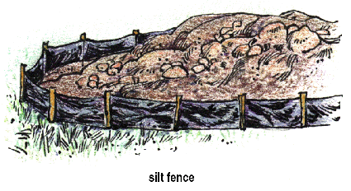
Regulatory Update: Construction Site Runoff Control
Stormwater Ordinance Overview
02
Rules and regulations must include:
  Requirements for erosion and sediment controls
  Requirements for waste control on construction sites
Created written procedures for:
  Site plan review
  Site inspection and enforcement
1-Acre Threshold

Slide 18
Regulatory Update: Construction Site Runoff Control
Stormwater Ordinance Overview
02
Chapter 417 Article III:
  Proper erosion and sedimentation controls shall be used at construction sites during land disturbance activities to ensure that pollutants are not introduced into stormwater.
  All construction debris shall be disposed of in a proper manner to prevent discharge to the municipal storm drain system.
1-Acre Threshold

Slide 19
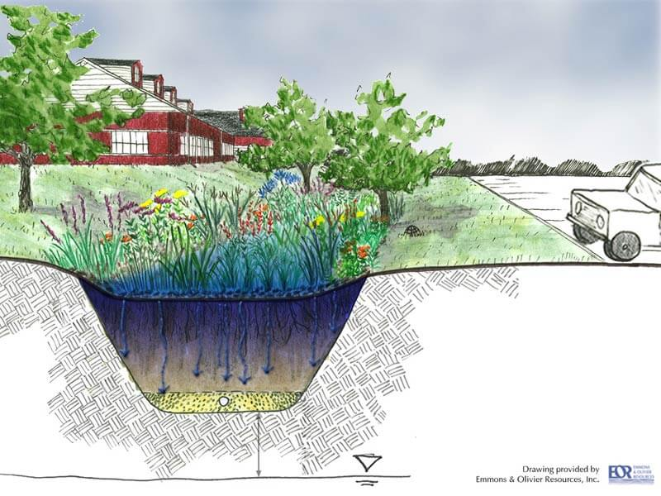
Regulatory Update: Post-Construction Runoff Control
Stormwater Ordinance Overview
02
Stormwater regulations must include:
  Requirements for use of Low-Impact Development (LID) in site design
  Pollutant removal requirements for stormwater treatment structures
  Requirements for long-term operation and maintenance of stormwater management systems
  Requirements for the submission of as-built plans
1-Acre Threshold;
Includes Subdivisions

Slide 20
Regulatory Update: Post-Construction Runoff Control
Stormwater Ordinance Overview
02
Chapter 417 Article III:
  Low Impact Development (LID) site planning and design strategies must be used to the maximum extent practicable (MEP).
  All redevelopment projects must additionally be designed in accordance with the treatment standards set forth in N.H. Code Admin. R. Part Env-Wq 1500.
  As-built drawings shall be submitted to the Municipal Services Department within 6 months after completion of construction.
  The owners of private storm drain systems, stormwater management systems, and BMPs shall be responsible for the long-term maintenance of all such systems.
1-Acre Threshold;
Includes Subdivisions

Slide 21
Regulatory Update: Enforcement, Right of Entry
Stormwater Ordinance Overview
02
Chapter 417 Article V Section 501:
  “The Director and other duly authorized employees or agents of the Town bearing proper credentials shall be permitted to enter all properties after 24 hours written notice to the property owner for the purposes of inspection, observation, and testing in accordance with the provisions of this Chapter”
Other communities (Manchester, NH and Derry, NH) include the following:
  “In the event the violation constitutes an immediate danger to public health or public safety, the DPW is authorized to enter upon the subject private property, without giving prior notice, to take any and all measures necessary to abate the violation and/or restore the property. The DPW is authorized to seek the costs of the abatement.”

Slide 22
Regulatory Update: Enforcement, Notice of Violation
Stormwater Ordinance Overview
02
Chapter 417 Article V Section 3.A:
  The Town Council or its agent shall be responsible for the enforcement of this chapter, including violation notices and enforcement orders, and may pursue all civil and criminal remedies for such violations.
  Any person, firm, partnership or corporation found to be in violation shall be served by the Town with written notice stating the nature of the violation and providing a 14-day period for the correction thereof.
Consistent with existing municipal code Chapter 264 Article X, Violations and Penalties, and Chapter 398, Sewer Use
  Any person found to be in violation of Chapter 264 “shall be served by the town with a written notice stating the nature of the violation and providing a fourteen-day period for the satisfactory correction thereof.”

Slide 23
Regulatory Update: Enforcement, Notice of Violation
Stormwater Ordinance Overview
02
Other communities (Manchester, NH and Derry, NH) have shorter correction periods
  2 days to act on notice of violation or five days to appeal.
  If the property owner does not act on a notice of violation, the DPW is authorized to perform the abatement themselves and seek costs from the property owner.
  Any unpaid abatement fee becomes a lien against the property.

Slide 24
Regulatory Update: Enforcement, Penalties
Stormwater Ordinance Overview
02
Chapter 417 Article V Section 3.B:
  “Any person who shall continue any violation beyond the time limit provided for shall be subject to enforcement action for each violation, as determined appropriate by the enforcement agent and as authorized by law. Separate fines will be levied for individuals and a corporation or an unincorporated association. Each day in which any such violations shall continue shall be deemed a separate offense. See, RSA 31:39, RSA 149-I:6 and RSA 676:17.”
    RSA 676:17 – States that violators of “any local ordinance, code, or regulation adopted under this title” shall be guilty of a misdemeanor if a natural person, or guilty of a felony if any other person, and shall be subject to a civil penalty of $275 for the first offense, and $550 for subsequent offenses.
Penalties vary from existing Chapter 264 Article X, Violations and Penalties:
  “Any person who shall continue any violation beyond the time limit provided shall be charged with committing a misdemeanor and, upon conviction thereof, shall be fined an amount not exceeding ten dollars ($10) for each violation. Each day in which any violation shall continue shall be deemed a separate offense.”

Slide 25
Regulatory Update: Enforcement, Penalties
Stormwater Ordinance Overview
02
Other communities (Manchester, NH and Derry, NH) set a higher cap for daily fines and stricter penalties for failure to remedy a violation:
  Up to $1,000/day for each day a violation remains unremedied after receipt of notice of violation
  Potential for criminal penalties– the DPW director may issue a citation to a violator requiring that person to appear in court and answer charges

Slide 26


Thank you!
Questions?
westonandsampson.com

