Slide 1
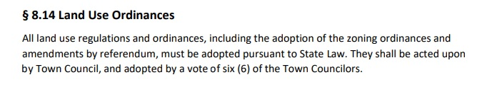
Town Council Form of Government and Zoning Amendments
Seven Other Town Council Forms of Government
Bedford, Derry, Durham, Hooksett, Londonderry, Merrimack, Newmarket
“abundant opportunities for public input… a dialogue throughout the amendment process” – Durham Town Administrator
“works quite well and is far more efficient… ample opportunity for public to weigh in…” – former Londonderry Town Administrator

Slide 2
Initiated by Planning Board
Refer Changes to PB
Initiated by Planning Board
- Recommendation at Public Hearing
(submit 14 days following meeting)
Town Council Host First Read at next scheduled meeting
Town Council Host Public Hearing
- 6 votes to pass
Pass
Supplemental Recommendation
Vote not to pass
(Amendment Dies)

Slide 3
Initiated by Town Council
Initiated by Town Council
Refer Changes to PB
Planning Board
- Recommendation at Public Hearing
*60 days from initial consideration
*TC grants extension at discretion
*14 days following meeting for rec.
Town Council Host First Read at next scheduled meeting
Town Council Host Public Hearing
- 6 votes to pass
Pass
Supplemental Recommendation
Vote not to pass
(Amendment Dies)

Slide 4
Initiated by Citizens
-by petition (75 Voters)
Initiated by Citizens
Refer Changes to PB
Planning Board
- Recommendation at Public Hearing
*60 days from initial consideration
*TC may grant 30 day extension
*14 days following meeting for rec
Town Council Host First Read at next scheduled meeting
Town Council Host Public Hearing
- 6 votes to pass
Pass
Supplemental Recommendation
Vote not to pass
(Amendment Dies)

Slide 5
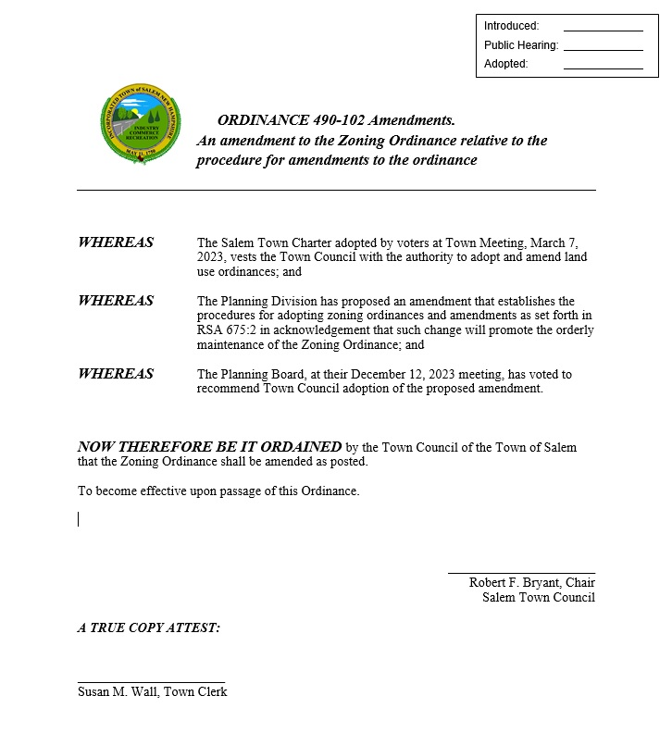
12/18/2023

Slide 6
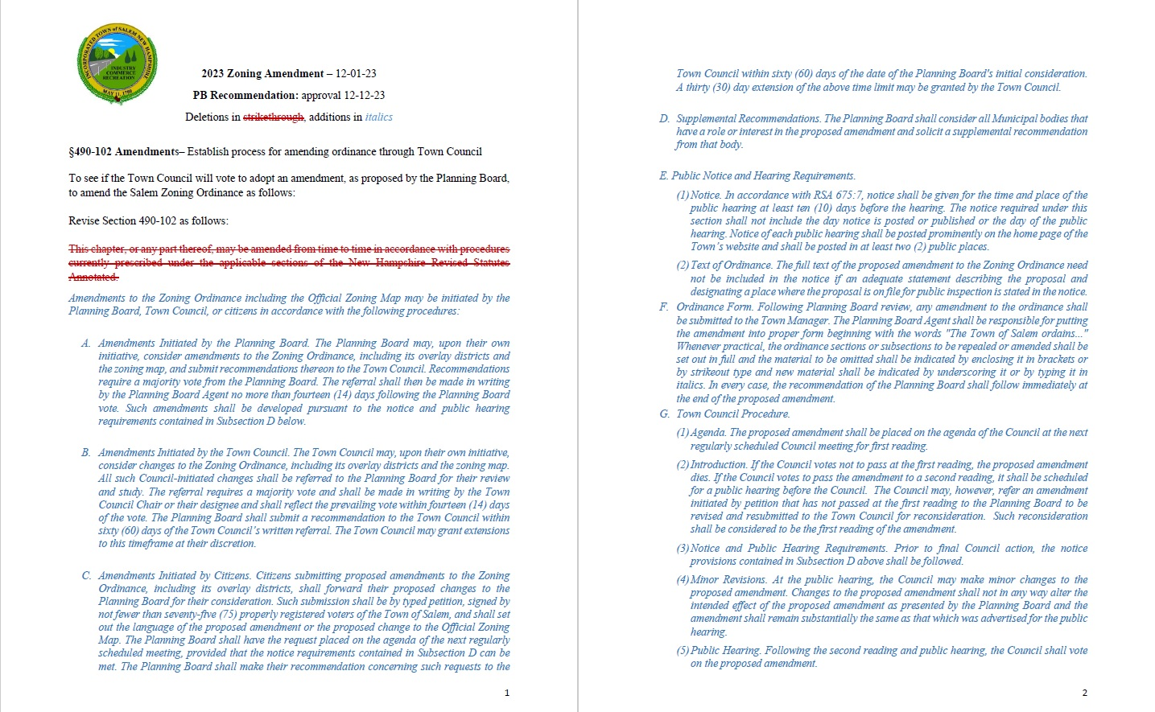

Slide 7
§490-102 Amendments– Establish process for amending ordinance through Town Council
A. Amendments Initiated by the Planning Board. The Planning Board may, upon their own initiative, consider amendments to the Zoning Ordinance, including its overlay districts and the zoning map, and submit recommendations thereon to the Town Council. Recommendations require a majority vote from the Planning Board. The referral shall then be made in writing by the Planning Board Agent no more than fourteen (14) days following the Planning Board vote. Such amendments shall be developed pursuant to the notice and public hearing requirements contained in Subsection D below.

Slide 8
§490-102 Amendments– Establish process for amending ordinance through Town Council
B. Amendments Initiated by the Town Council. The Town Council may, upon their own initiative, consider changes to the Zoning Ordinance, including its overlay districts and the zoning map. All such Council-initiated changes shall be referred to the Planning Board for their review and study. The referral requires a majority vote and shall be made in writing by the Town Council Chair or their designee and shall reflect the prevailing vote within fourteen (14) days of the vote. The Planning Board shall submit a recommendation to the Town Council within sixty (60) days) of the Town Council’s written referral. The Town Council may grant extensions to this timeframe at their discretion.

Slide 9
§490-102 Amendments– Establish process for amending ordinance through Town Council
D. Supplemental Recommendation. The Planning Board shall consider all municipal bodies that have a role or interest in the proposed amendment and solicit a supplemental recommendation from that body.

Slide 10
§490-102 Amendments– Establish process for amending ordinance through Town Council
(4) Minor Revisions. At the public hearing, the Council may make minor textual changes to the proposed amendment. Changes to the proposed amendment shall not in any way alter the intended effect of the amendment as presented by the Planning Board and the amendment shall remain substantially the same as that which was advertised for the public hearing.

