Slide 1
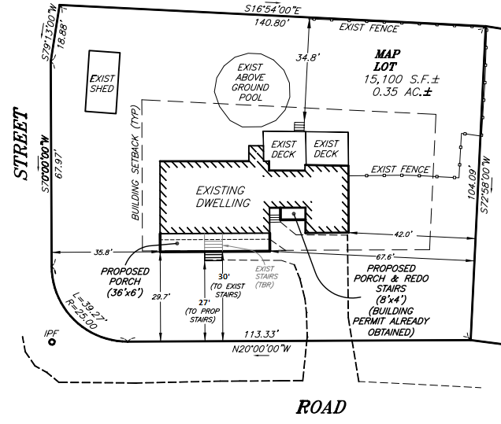


Corner lot setbacks §490-202
Codify traditional practice of applying “two fronts and two sides for corner lots:
“A front yard bordering on each street line and a side yard adjacent to all other lot lines.”

Slide 2
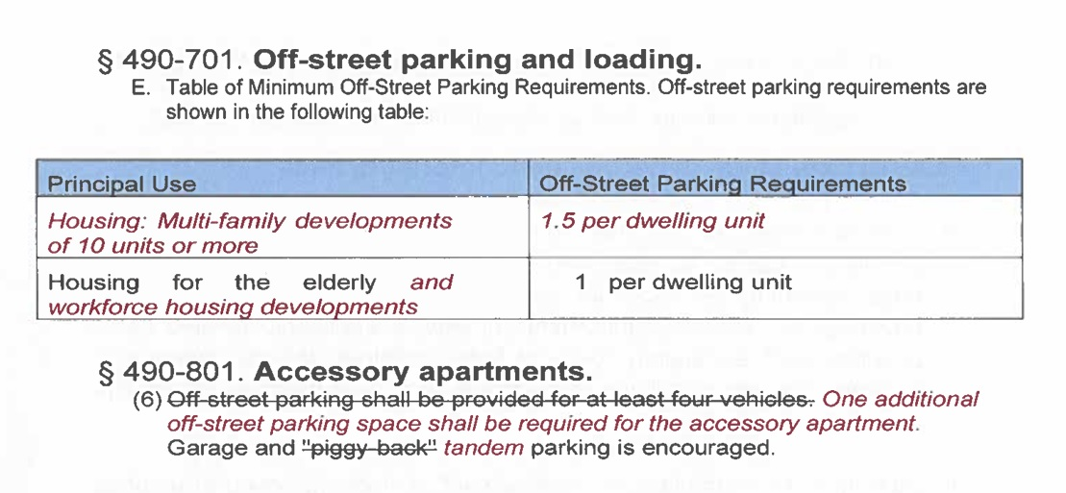
Updating parking requirements for multi-family, workforce housing and ADUs
§490-701 & §490-801
To comply with State Law and meet NH BEA Housing Champion Criteria

Slide 3
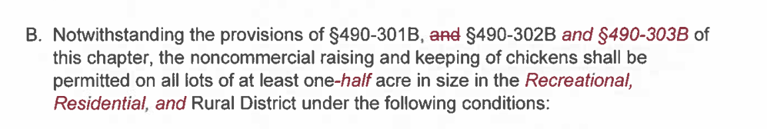
Non-commercial keeping of chickens
§490-713
Reducing lot size to one-half acre
Allowing in all residential districts (Recreational, Residential, Rural)
Municipality | Quantity | Lot Size | Districts
Concord | 5 | <1 acre | Residential
Derry |  | n/a | Residential
Londonderry | 6-12 | .5 acre – 1 acre | Residential
Manchester | 6 | .5 acre | Residential
Nashua |  | .7 acre -.9 acre | R-30 & R-40
Windham |  | n/a | Residential

Slide 4
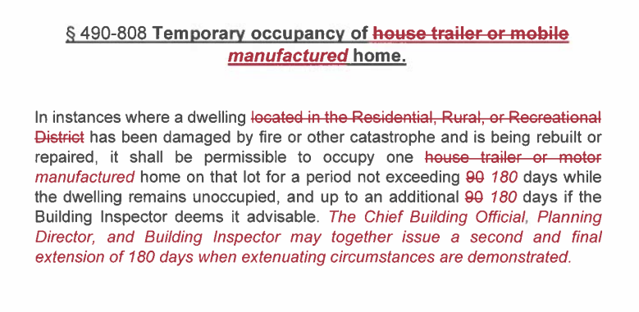
Temporary occupancy of manufacture home
§490-808

Slide 5
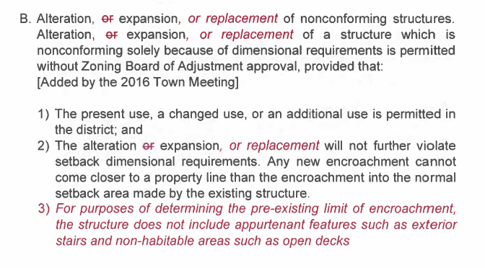
Expansion of certain nonconforming uses
§490-810

Slide 6
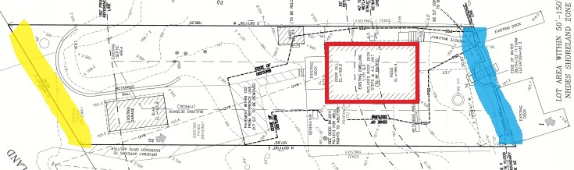
Expansion of certain nonconforming uses
§490-810

